Slide 1
Chapter 3 Processes

Slide 2
教学内容、目标与要求
教学内容
进程概念
进程调度
进程操作
进程通信
IPC系统实例
Client-Server系统中的通信
教学重点及难点
重点：1、2、3、4
难点：1、3
教学目标与要求
掌握进程基本概念；
掌握进程状态的迁移及原因；
理解进程创建过程及进程控制；
了解客户机-服务器系统中的通信。

Slide 3
Contents
3.1 Process Concept
3.2 Process Scheduling
3.3 Operations on Processes
3.4 Interprocess Communication
3.5 Example of IPC Systems
3.6 Communication in Client-Server Systems

Slide 4
3.1 Process Concept
An OS executes a variety of programs:
Batch system – jobs
Time-shared systems – user programs or tasks
terms job and process used almost interchangeably.
Process -- a program in execution.
process execution must progress in sequential fashion.
Program is passive entity stored on disk (executable file), process is active.
Program becomes process when executable file loaded into memory.
Execution of program started via GUI mouse clicks, command line entry of its name, etc.
One program can be several processes.

Slide 5
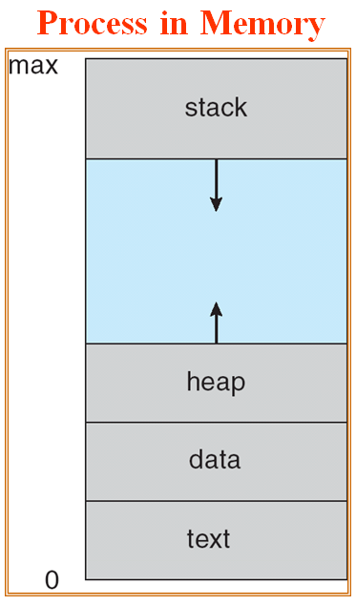
Process Concept
A process includes:
program code, known as text section.
data section, contains global variables.
heap, containing memory dynamically allocated during run time.
process stack, contains temporary data
function parameters, return value
return addresses
local variables
current activity, represented by the value of the program counter and the contents of the processor’s register.

Slide 6
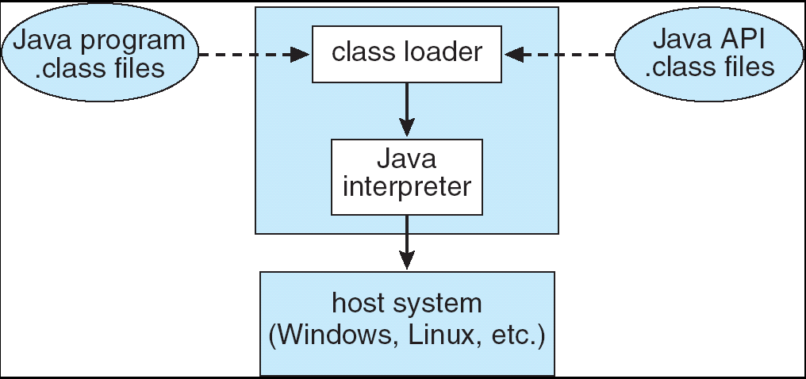
Process Concept
A process itself can be an execution environment for other code.
Java programming environment
An executable Java program is executed within the Java virtual machine (JVM).
The JVM executes as a process
interprets the loaded Java code
takes actions (via native machine instructions) on behalf of that code.
E.g. java Program
command java runs the JVM as an ordinary process.
JVM executes the Java program.

Slide 7
Process State
As a process executes, it changes state.
A process may be in one of the following states:
new: The process is being created.
running: Instructions are being executed.
waiting: The process is waiting for some event to occur.
ready: The process is waiting to be assigned to a processor.
terminated: The process has finished execution.
Only one process can be running on any processor at any time, many processes may be ready and waiting.

Slide 8
Diagram of Process State
new
Terminated
Scheduler dispatch
exit
admitted
ready
running
Interrupt / timeout
I/O completion
or event occurs
I/O or event wait
waiting
结合自己的大学生活，理解进程的状态变迁。
process？
States: new? terminate? ready? running? waiting?
condition?

Slide 9
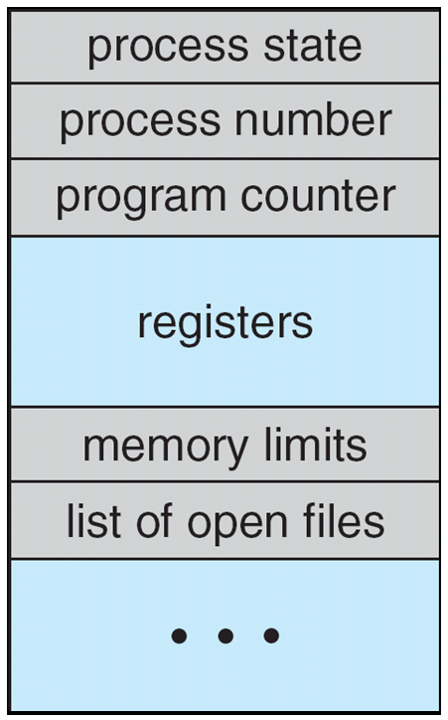
Process Control Block (PCB)
Each process is represented by a PCB.
PCB is also called task control block.
contains info associated with each process:
process state
Program Counter
CPU registers
CPU scheduling information - priorities, scheduling queue pointers
memory-management information
accounting information – the amount of CPU time used, clock time elapsed since start, time limits, account numbers, etc.
I/O status information – the list of I/O devices allocated to process, a list of open files, and so on.
process number -- Identifiers, e.g. Identifier of this process , Identifier of its parent process, User identifier.
A1: openEuler PCB

Slide 10
CPU Switch From Process to Process (Figure 3.4)
Process P₀ Operating System process P₁
running
Interrupt or system call
Save state into PCB₀
...
ready
idle
CPU scheduler
reload state from PCB₁
ready
idle
Interrupt or system call
running
Save state into PCB₁
...
CPU scheduler
ready
idle
reload state from PCB₀
running

Slide 11
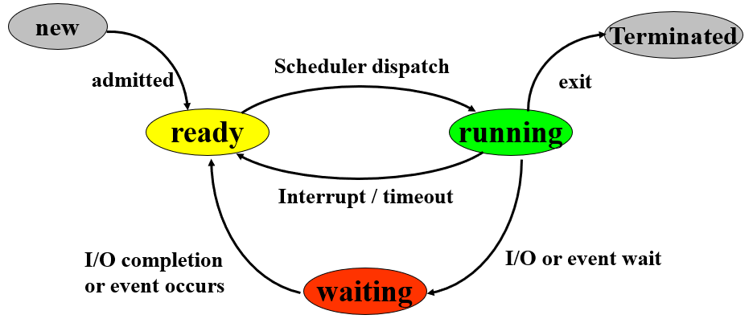
When to Switch a Process
Clock interrupt
process has executed for the maximum allowable time slice
I/O interrupt
Memory fault
memory address is in virtual memory so it must be brought into main memory.
Trap
error occurred
may cause process to be moved to terminated/exit state
System call
such as file open

Slide 12
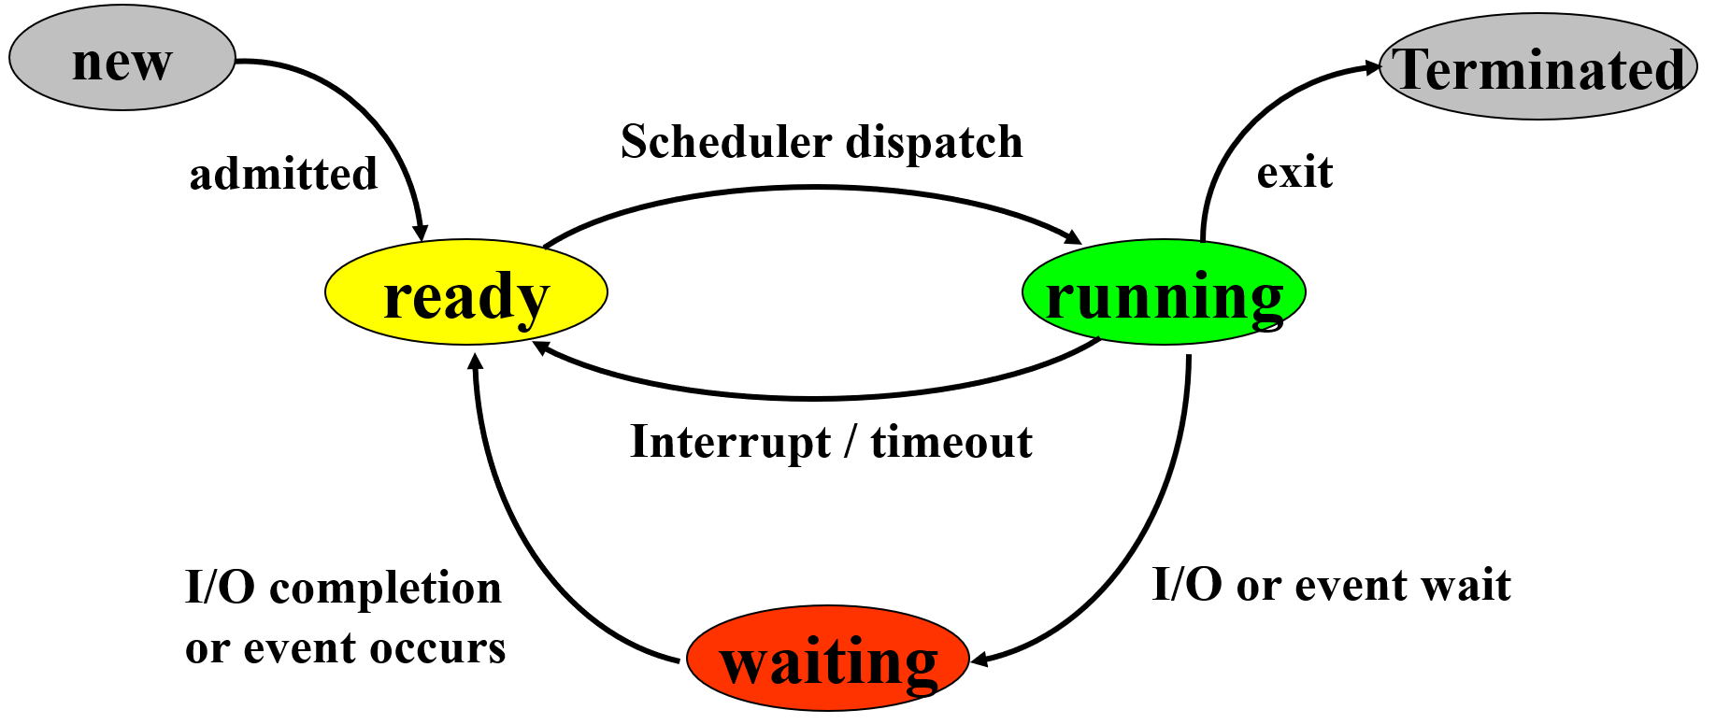
Exercise 1
Considering process state transitions, which of the following migration is impossible? .
A. running → ready
B. ready → running
C. waiting → ready
D. ready → waiting
E. running → waiting
F. waiting → running
G. ready → terminated
H. new → running

Slide 13
Threads
So far, process has a single thread of execution.
This single thread of control allows the process to perform only one task at a time.
E.g. a word-processor program, cannot simultaneously type in characters and run the spell checker within the same process.
A process have multiple threads of execution
multiple threads can run in parallel
has multiple program counters
multiple threads of control --> threads
Must then have storage for thread details, multiple program counters in PCB.

Slide 14
3.2 Process Scheduling
多道程序设计：内存共享
CPU调度：CPU共享
The objective of multiprogramming: to maximize CPU utilization.
The objective of time sharing: users can interact with each program while it is running.
switch the CPU among processes frequently.
process scheduler： selects an available process for execution on the CPU.
On a single-processor system,
only one running process at most.
the rest will have to wait until the CPU is free and can be rescheduled.

Slide 15
Scheduling Queues
Job queue – set of all processes in the system.
Ready queue – set of all processes residing in main memory, ready and waiting to execute.
generally stored as a linked list.
header contains pointers to the first and final PCBs in the list.
queue header
PCB₇
PCB₂
ready
head
queue
tail
registers
registers
┇
┇

Slide 16
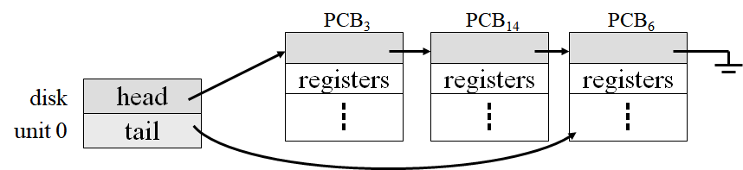
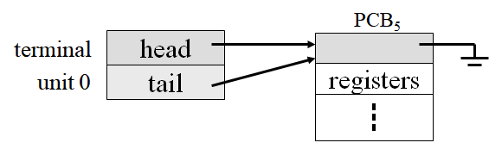
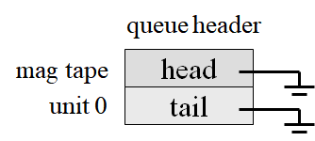
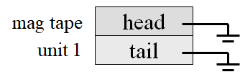
Scheduling Queues
Device queues – List of processes waiting for an I/O device.
Each device has its own device queue.

Slide 17
Representation of Process Scheduling
Queueing diagram represents queues, resources, flows.
interrupt
dispatched
CPU
ready queue
I/O
I/O queue
I/O request
time slice
expired
child
executes
fork a child
event
occurs
wait for an
event

Slide 18
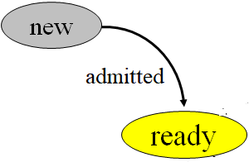

Schedulers
Long-term scheduler (or job scheduler)
selects which processes should be brought into the ready queue.
Short-term scheduler (or CPU scheduler)
selects which process should be executed next and allocates CPU.
Primary distinction: execution frequency.
Short-term / CPU scheduler is invoked very frequently (milliseconds) ⇒ scheduler must be fast.
Long-term / job scheduler is invoked very infrequently (seconds, minutes) ⇒ scheduler may be slow.
The long-term scheduler controls the degree of multiprogramming, the number of processes in memory.

Slide 19
Schedulers
Processes can be described as either:
I/O-bound process : spends more time doing I/O than computations; many short CPU bursts.
CPU-bound process : spends more time doing computations; few very long CPU bursts.
Select a good process mix.
If all processes are I/O-bound, the ready queue will almost always be empty, and CPU scheduler will have little to do.
If all processes are CPU-bound, the I/O waiting queue will almost always be empty, devices will go unused.

Slide 20
Schedulers
Processes can be described as either:
I/O-bound process :
spends more time doing I/O than computations; many short CPU bursts.
CPU-bound process :
spends more time doing computations; few very long CPU bursts.
Select a good process mix.
If all processes are I/O-bound
the ready queue will almost always be empty, and CPU scheduler will have little to do.
If all processes are CPU-bound
the I/O waiting queue will almost always be empty, devices will go unused.

Slide 21
Medium-Term Scheduling
interrupt / timeout
swap out
scheduled &
dispatched
ready queue
CPU
end
swap out
I/O
requesting
I/O
scheduling
I/O done
I/O waiting
queue
swap in
I/O
swapped ready
swap in
swap out
swapped waiting
I/O done
The process is swapped out, store on disk, and is later swapped in, by the medium-term scheduler.

Slide 22
Swapped/Suspended Processes
Processor is faster than I/O so all processes could be waiting for I/O.
Swap these processes to disk to free up more memory.
Waiting state becomes swapped waiting when swapped to disk.
Two new states
swapped waiting (suspended waiting / suspended blocked)
swapped ready (suspended ready)

Slide 23
Reasons for Process swapped out
Swapping | The OS needs to release sufficient main memory to bring in a process that is ready to execute.
Other OS reason | The OS may suspend a background or utility process or a process that is suspected of causing a problem.
Interactive user request | A user may wish to suspend execution of a program for purpose of debugging or in connection with the use of a resource.
Timing | A process may be executed periodically (e.g., an accounting or system monitoring process) and may be suspended while waiting for the next time interval.
Parent process request | A parent process may wish to suspend execution of a descendant to examine or modify the suspended process, or to coordinate the activity of various descendants.

Slide 24
Context Switch
The context is represented in the PCB of the process.
When CPU switches to another process, the system must save the state of the old process and load the saved state for the new process. Known as a context switch.
Save context of processor including program counter and other registers
Update the PCB of the process that is currently running
Move PCB to appropriate queue - ready, waiting
Select another process for execution (--scheduling)
Update the PCB of the process selected
Update memory-management data structures
Restore context of the selected process
Context-switch time is pure overhead.
The system does no useful work while switching.
Context-switch times dependent on hardware support.

Slide 25
Exercise 2
There are 10 processes executing concurrently in a single-processor system.
The number of processes in running state: max:___________min:___________
The number of processes in ready state: max:___________min:___________
The number of processes in waiting state: max:___________min:___________
_________________selects from among the processes that are ready to execute and allocates the CPU to one of them.
The _________________ scheduler controls the degree of multiprogramming (the number of processes in memory).
The process is swapped out, and is later swapped in, by the ______________ scheduler.

Slide 26
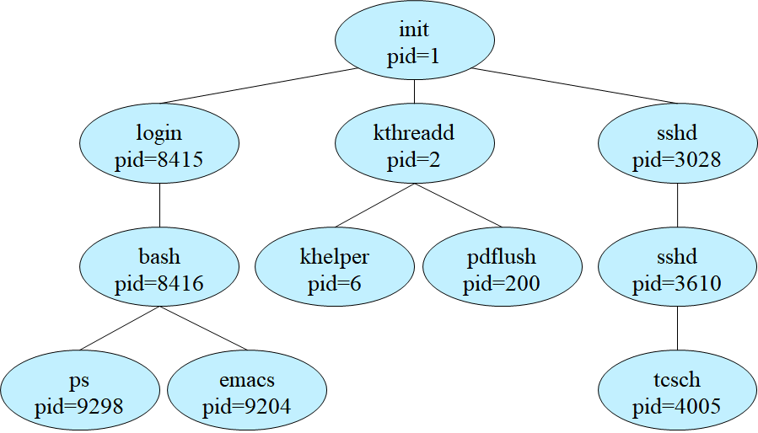
3.3 Operations on Processes
Process Creation
Reason for Process Creation
Submission of a batch job
User logs on
Created to provide a service such as printing
Process creates another process
A typical process tree for Linux OS

Slide 27
Process tree in openEuler
内核使用静态数据 init_task 创建0号进程
内核启动
0号进程
idle进程
0号进程完成内核初始化；
创建1号进程和2号进程；
（三个进程均运行在内核态，无用户空间）
0号进程演变为idle进程，一直运行在内核中。
Kernel_thread()
1号进程
2号进程（kthreadd内核线程）
/sbin/init程序
2号进程，kthreadd 内核线程。
一直运行在内核空间。
对之后所有内核线程进行管理和调度。
进程树
init进程（用户进程）
Pid=3
1号进程完成剩下的系统初始化工作；
执行 /sbin/init 程序，初始化用户空间，成为init 进程，运行在用户态下；
所有用户进程的祖先进程，负责孤儿进程的管理与回收。
Pid=4
Pid=56
Pid=90
Pid=128
…

Slide 28
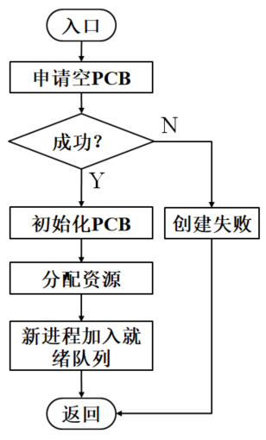
Process Creation
Assign a unique process identifier, an integer number.
Allocate space for the process
Initialize process control block (PCB)
Set up appropriate linkages
e.g. add new process to linked list used for scheduling queue
Create or expand other data structures
e.g. maintain an accounting file
Resource sharing
Parent and children share all resources.
Children share subset of parent’s resources.
Parent and child share no resources.
When a process is created, it obtains initialization data that may be passed along from the parent process to the child process.

Slide 29
Process Creation
Execution，two possibilities：
Parent and children execute concurrently.
Parent waits until some or all of its children terminate.
Address space，two possibilities：
Child is a duplicate of the parent.
Child has a program loaded into it.
UNIX examples
each process is identified by its process identifier, an unique integer
system call fork() creates new process
system call exec() used after a fork to replace the child process’ memory space with a new program.
A2: openEuler
Process Creation

Slide 30
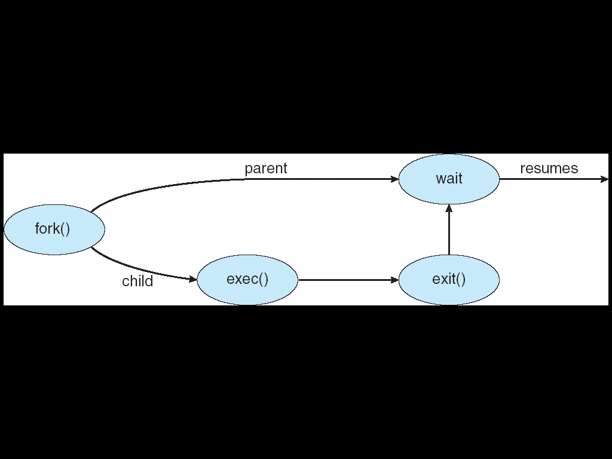
C program forking a separate process
#include <sys/types.h>
#include <stdio.h>
#include <unistd.h>
void main( )
{
pid_t pid;
pid=fork(); // fork a child process
if (pid<0) { // error occurred
fprientf(stderr, “Fork failed”);
exit(-1);
}
else if (pid==0) { // child process
execlp(“/bin/ls”, “ls”, null);
}
else { // parent process
wait(null); // parent process will wait for the child to complete
printf(“Child Complete”);
exit(0);
}
}

Slide 31
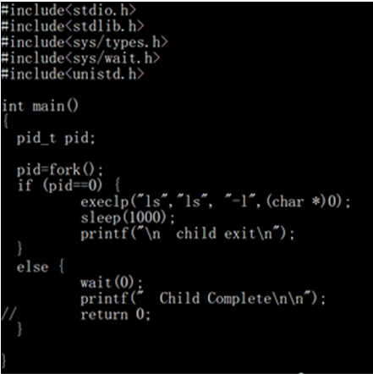
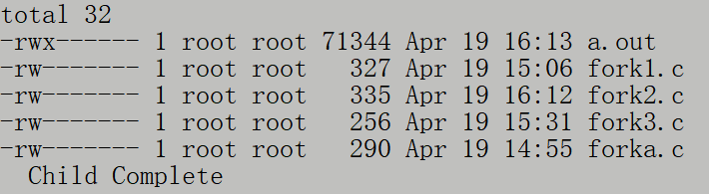
C program forking a separate process
A3: openEuler
Exec()

Slide 32
Creating a separate process using the win32 API
#include <windows.h>
#include <stdio.h>
int main( VOID )
{
STARTUPINFO si;
PROCESS_INFORMATION pi;
ZeroMemory( &si, sizeof(si) );
si.cb = sizeof(si);
ZeroMemory( &pi, sizeof(pi) );
if ( !CreateProcess ( NULL, // use command line
"C:\\WINDOWS\\system32\\mspaint.exe",
NULL, // don’t inherit process handle
NULL, // don’t inherit thread handle
FALSE, // disable handle inheritance
0, // no creation flags.
NULL, // use parent's environment block
NULL, // use parent's existing directory
&si,
&pi ) )
{ fprintf( stderr, "Create Process failed \n" );
return -1;
}
WaitForSingleObject( pi.hProcess, INFINITE );
printf("Child Complete");
CloseHandle( pi.hProcess );
CloseHandle( pi.hThread );
}
用于指定新进程的主窗口特性
返回有关新进程及其主线程的信息
create process

Slide 33
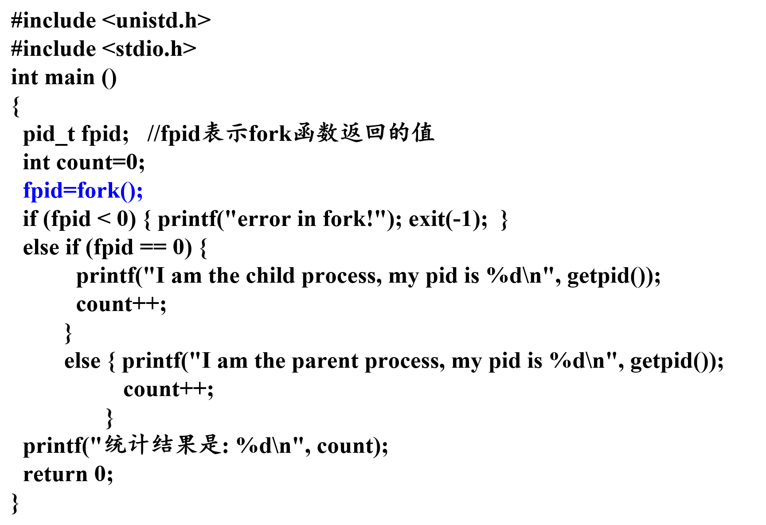
Exercise 3
I am the parent process, my pid is …
统计结果是: 1
I am the child process, my pid is …
统计结果是: 1

Slide 34
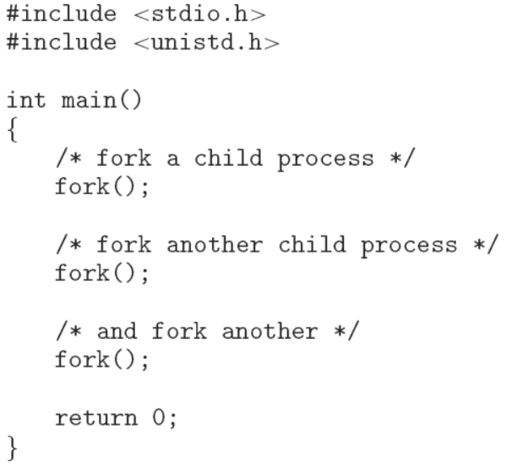
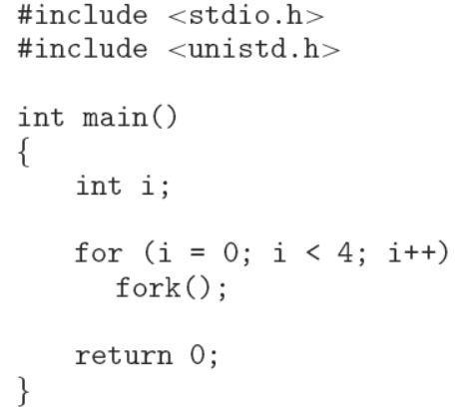
Exercise 4
How many processes are created?

Slide 35
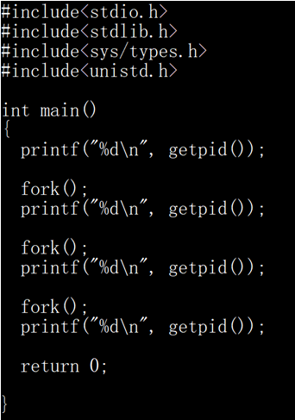


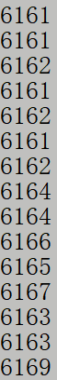
Exercise 4

Slide 36
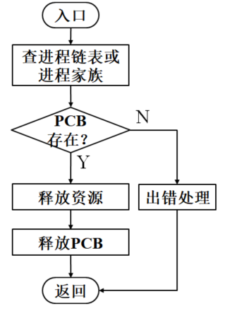
Process Termination
Batch job issues Halt instruction
User logs off
Quit an application
Error and fault conditions

Slide 37
Reasons for Process Termination
Normal completion
Time limit exceeded
Memory unavailable
Bounds violation
Protection error
example write to read-only file
Arithmetic error
Time overrun
process waited longer than a specified maximum for an event.
I/O failure (e.g. file unfinded)
Invalid instruction
happens when try to execute data
Privileged instruction
Data misuse (e.g. type error)
Operating system intervention
such as when deadlock occurs
Parent terminates so child processes terminate
Parent request

Slide 38
Process Termination
Process executes last statement and asks the OS to delete it (via exit).
Output data from child to parent (via wait).
Process’ resources are deallocated by OS.
Parent may terminate execution of its children processes (via abort) for a variety of reasons:
Child has exceeded its usage of allocated resources.
Task assigned to child is no longer required.
Parent is exiting.
Operating system does not allow child to continue if its parent terminates.
Cascading termination, normally initiated by the operating system.
A4: openEuler
进程终止

Slide 39
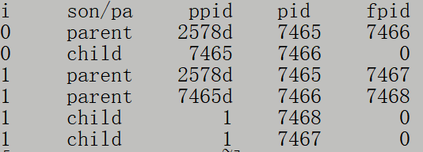
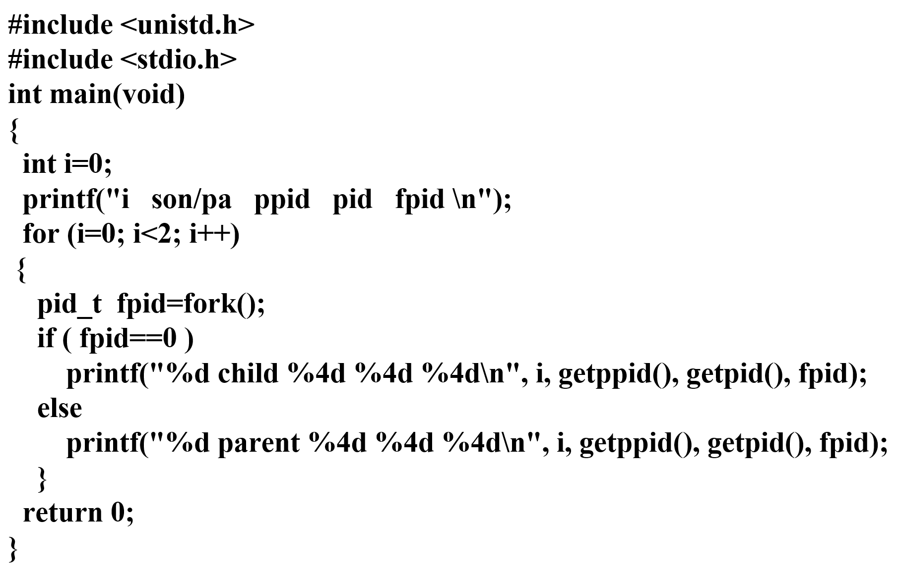
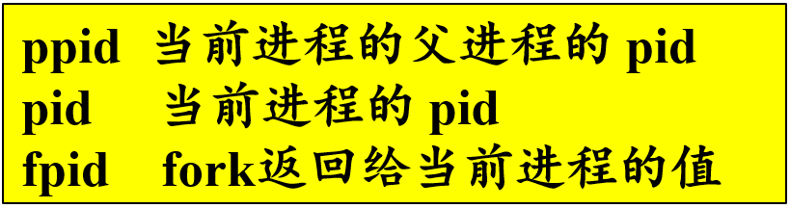
Exercise 5
2578
main()
7465
7466
7467
7468

Slide 40
3.4 Interprocess Communication
Independent process cannot affect or be affected by the execution of another process.
Cooperating process can affect or be affected by the execution of another process
Advantages of process cooperation
Information sharing
Computation speed-up
Modularity
Convenience
Two fundamental models
Shared-memory
Message passing
学生：独立的个体；
学生之间的关系：
竞争? 合作?
大学资源：?
共享? 独占?

Slide 41
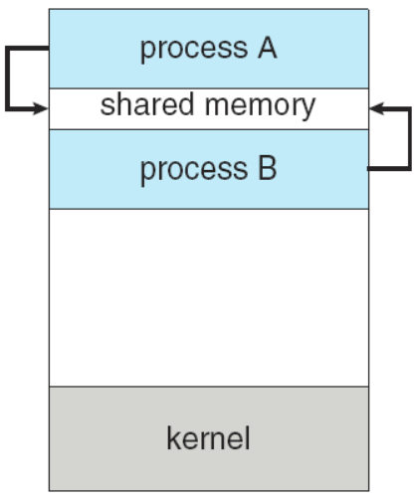
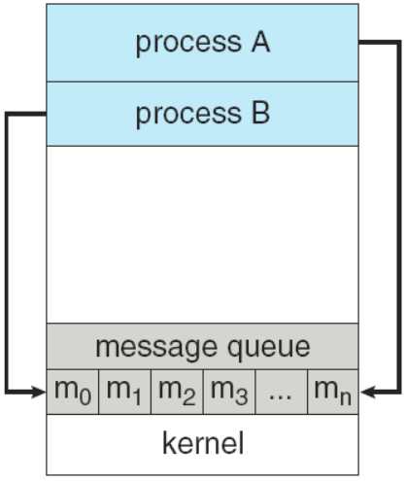
Communication Models
Shared memory
allows maximum speed and convenience of communication.
It can be done at memory speeds when within a computer.
Message passing
useful when smaller numbers of data need to be exchanged, because no conflicts need to be avoided.
easier to implement for intercomputer communication.

Slide 42
Shared-memory systems -- Producer-Consumer Problem
A common paradigm for cooperating processes: producer process produces information that is consumed by a consumer process.
we must have available a buffer of items that can be filled by the producer and emptied by the consumer.
A producer can produce one item while the consumer is consuming another item.
The producer and consumer must be synchronized.
Two types of buffer used
unbounded-buffer places no practical limit on the size of the buffer.
bounded-buffer assumes that there is a fixed buffer size.

Slide 43
Shared-memory solution to Producer-Consumer Problem
Shared data
#define BUFFER_SIZE 10
typedef struct {
. . .
} item;
item buffer[BUFFER_SIZE];
int in = 0;
int out = 0;
in points to the next free position in the buffer;
out points to the first full position in the buffer.
the buffer is empty when in==out;
the buffer is full when ((in+1) % buffer_size)==out.
solution is correct, but can only use BUFFER_SIZE-1 elements

Slide 44
Shared Buffer--Circular array
in
out
in
in
buffer is empty when in==out;
buffer is full when
(in+1) % buffer-size ==out.
in
in
out
in
in
out
in
in
n-1
n
0
out
1
in
n-2
2
in
生产者和消费者：
竞争? or 合作?
3
4
in
in
…
5
6
in
in
in
in
solution is correct,
but can only use N-1 elements
in
in

Slide 45
Solution to bounded-buffer problem
Producer Process
item nextProduced;
while (1) {
/* produce an item in nextProduced */
…
while (((in+1)%BUFFER_SIZE) == out)
; /* do nothing */
buffer[in] = nextProduced;
in=(in+1)%BUFFER_SIZE;
}
Consumer Process
item nextConsumed;
while (1) {
while (in == out)
; /* do nothing */
nextConsumed = buffer[out];
out=(out+1) % BUFFER_SIZE;
/* consume the item in nextConsumed */
…
}

Slide 46
Message-passing systems--Interprocess Communication (IPC)
Mechanism for processes to communicate and to synchronize their actions.
Message passing system – processes communicate with each other without resorting to shared variables.
IPC facility provides at least two operations:
send(message) – message size fixed or variable
receive(message)
If P and Q wish to communicate, they need to:
establish a communication link between them
exchange messages via send/receive
Implementation of communication link
physical aspects (e.g., shared memory, hardware bus, network)
logical aspects (e.g., logical properties)

Slide 47
Implementation Questions
Direct / indirect communication?
Synchronous / asynchronous communication?
Automatic / explicit buffering?
How are links established?
Can a link be associated with more than two processes?
How many links can there be between every pair of communicating processes?
What is the capacity of a link?
Is the size of a message that the link can accommodate fixed or variable?
Is a link unidirectional or bi-directional?

Slide 48
Direct Communication--naming
Processes must name each other explicitly:
send (P, message) – send a message to process P
receive(Q, message) – receive a message from process Q
Properties of communication link
Links are established automatically.
A link is associated with exactly one pair of communicating processes.
Between each pair there exists exactly one link.
link may be unidirectional, but is usually bi-directional.
Asymmetry in addressing：receive (id, message)
disadvantages
Limited modularity of the resulting process definitions

Slide 49
Indirect Communication
Messages are sent and received from mailboxes (also referred to as ports).
Each mailbox has a unique id.
Processes can communicate only if they share a mailbox.
Primitives are defined as:
send(A, message) – send a message to mailbox A
receive(A, message) – receive a message from mailbox A
Properties of communication link
Link established only if processes share a common mailbox
A link may be associated with many processes.
Each pair of processes may share several communication links.
Link may be unidirectional or bi-directional.

Slide 50
Indirect Communication
Mailbox sharing
P₁, P₂, and P₃ share mailbox A.
P₁, send(A, message); P₂ and P₃ , receive(A, message)
Who gets the message?
Solutions
Allow a link to be associated with at most two processes.
Allow only one process at a time to execute a receive() operation.
Allow the system to select arbitrarily the receiver. Sender is notified who the receiver was.

Slide 51
Indirect Communication
A mailbox may be owned either by a process or by the operating system.
If owned by a process
owner can only receive messages through this mailbox
user can only send messages to the mailbox
if owned by the OS
the mailbox is independent
not attached to any particular process
OS provides mechanism allowing a process to do following operations
create a new mailbox
send and receive messages through mailbox
delete a mailbox

Slide 52
Synchronization
Message passing may be either blocking or non-blocking.
Blocking is considered synchronous
Blocking send: sending process is blocked until the message is received by the receiving process or by the mailbox.
Blocking receive: receiver blocks until a message is available.
Non-blocking is considered asynchronous
Nonblocking send: sending process sends the message and resumes operation.
Nonblocking receive: receiver retrieves either a valid message or a null.

Slide 53
Buffering
Queue of messages attached to the link; implemented in one of three ways.
Zero capacity – 0 messages Sender must wait for receiver (rendezvous).
Bounded capacity – finite length of n messages Sender must wait if the link is full.
Unbounded capacity – infinite length Sender never waits.

Slide 54
3.5 Example of IPC systems
POSIX shared memory
Message passing in the Mach operating system
Windows

Slide 55
3.6 Communication in Client-Server systems
Sockets
Remote Procedure Calls (RPC)
Remote Method Invocation (RMI, Java)
Pipes

Slide 56
RPCs
The semantics of RPCs allow a client to invoke a procedure on a remote host as it would invoke a procedure locally. By providing a stub on the client side
Stubs, client-side proxy for the actual procedure on the server.
The client-side stub locates port on the server and marshals the parameters, transmits a message to the server.
The server-side stub receives this message, unpacks the marshaled parameters, and performs the procedure on the server. Return values are passed back to the client using the same technique.

Slide 57
RPCs
machine-independent representation of data, external data representation (XDR).
Client, converting machine-dependent data into XDR.
server, XDR data is unmarshelled and converted into the machine-dependent representation.
The semantics of a call, exactly once
"at most once", attaching to each message a timestamp. the server must keep a history of all the timestamps of messages it has already processed.
"exactly once", Server sends ACK message to client.
the communication between a server and a client
binding information may be predetermined, fixed port address.
binding can be done dynamically by a rendezvous mechanism.

Slide 58
Execution of RPC
client message server
user calls kernel to send RPC message to procedure X
kernel sends message to
matchmaker to find port number
From: client to: server
Port: matchmaker
Re: address for RPC X
Matchmaker receives message, looks up answer
From:server to: client
Port: kernel
Re: RPC X port: P
Matchmaker replies to client
with port P
kernel place port P in user
RPC message
From: client to: server
Port: port P
<contents>
kernel sends RPC
daemon listening to port P receives message
From:RPC Port P
To: client Port: kernel
<output>
kernel receives reply, passes it to user
daemon processes request and processes send output

Slide 59
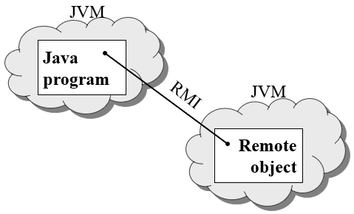
RMI -- Remote Method Invocation
RMI is a Java mechanism similar to RPCs.
RMI allows a Java program on one machine to invoke a method on a remote object.

Slide 60
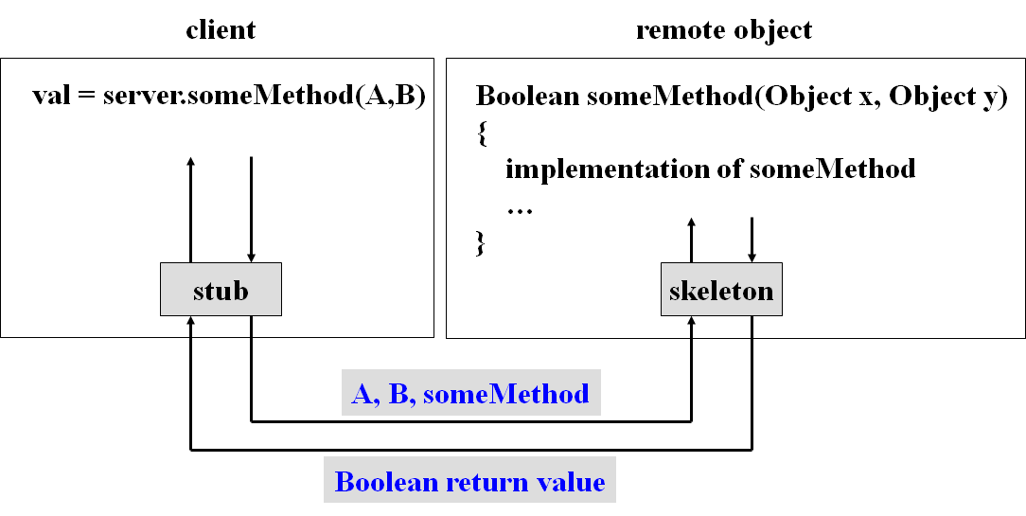
Marshalling Parameters
RMI implements the remote object using stubs and skeletons, so remote methods are transparent to both the client and the server.
A stub is a proxy for the remote object, resides with the client.
The skeleton is responsible for unmarshalling the parameters and invoking the desired method on the server.

Slide 61
pipes
Ordinary Pipes
Named Pipes

Slide 62
Pipes
Acts as a conduit allowing two processes to communicate.
Issues must be considered:
unidirectional or bidirectional?
If two-way communication, is it half or full-duplex?
Must a relationship (i.e., parent-child) exist between the communicating processes?
Can the pipes be used over a network?
Ordinary pipes – cannot be accessed from outside the process that created it.
Typically, a parent process creates a pipe and uses it to communicate with a child process that it created.
Named pipes – can be accessed without a parent-child relationship.

Slide 63
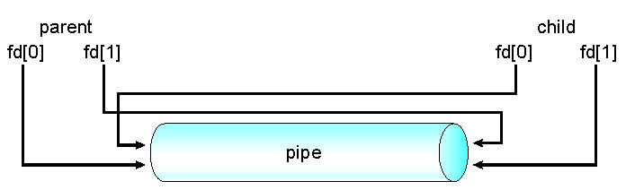
Ordinary Pipes
allow communication in standard producer-consumer style.
Producer writes to one end (the write-end ) of the pipe.
Consumer reads from the other end (the read-end )of the pipe.
Ordinary pipes are unidirectional.
Require parent-child relationship between processes.
Windows calls these anonymous pipes.

Slide 64
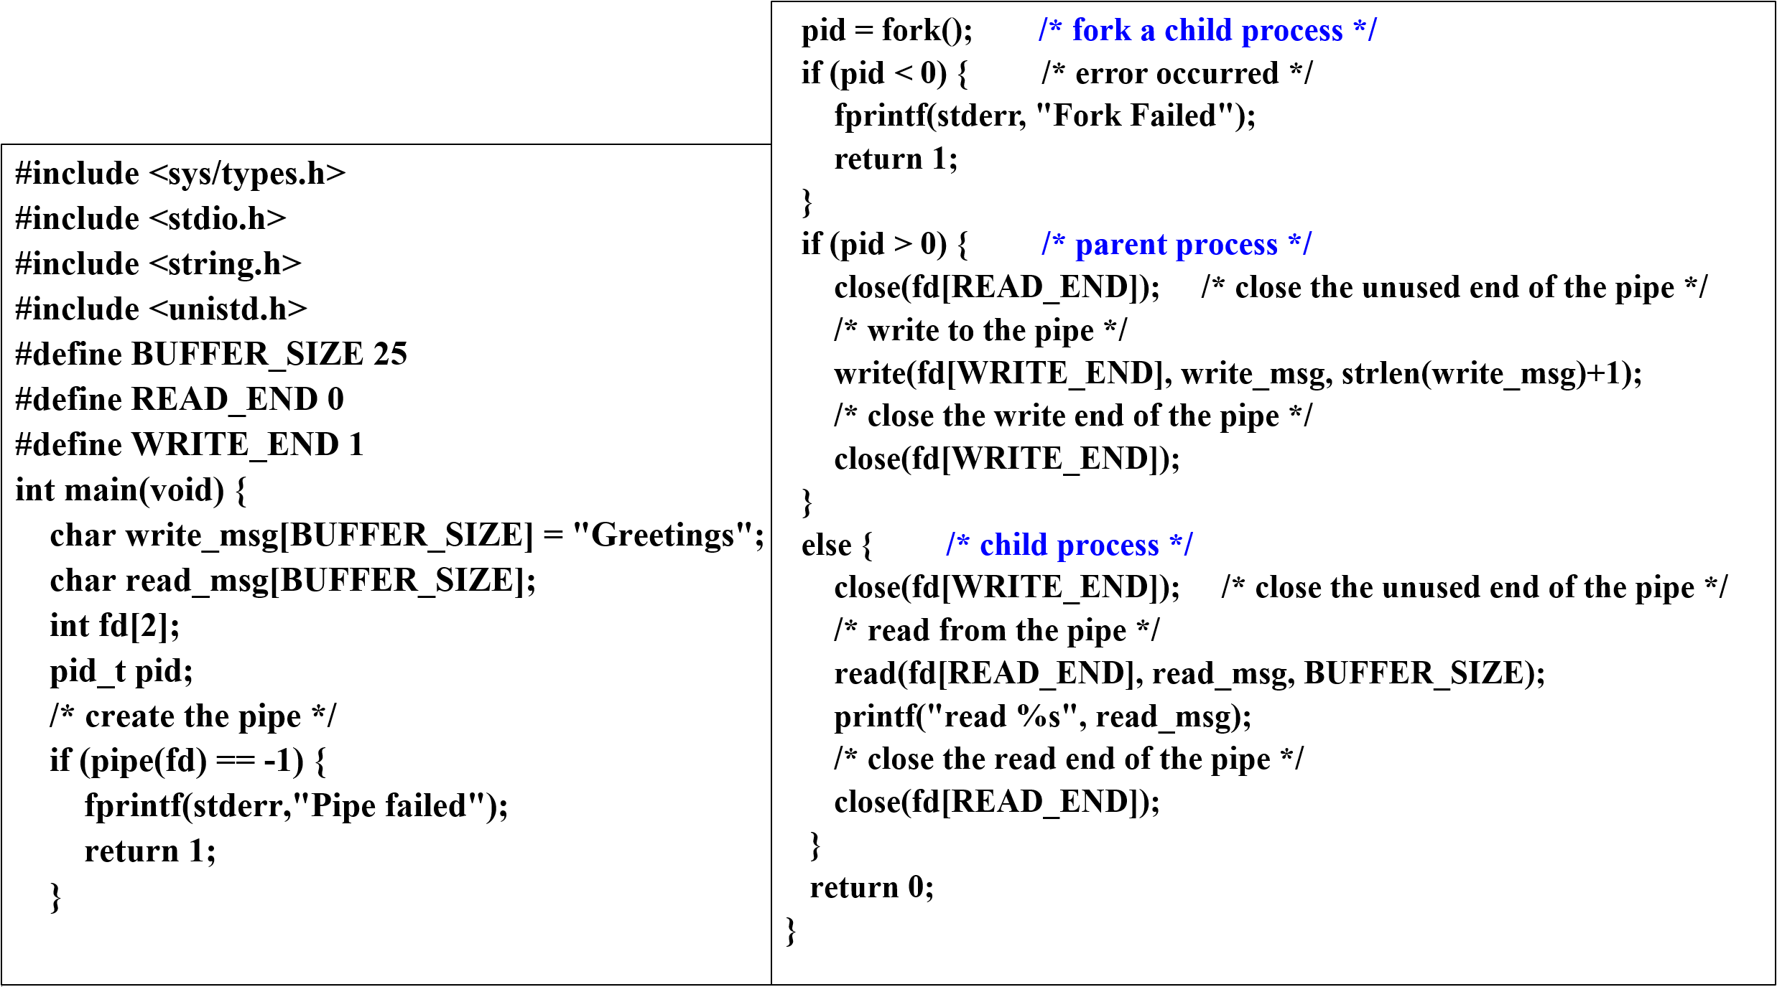
Ordinary pipe in UNIX

Slide 65
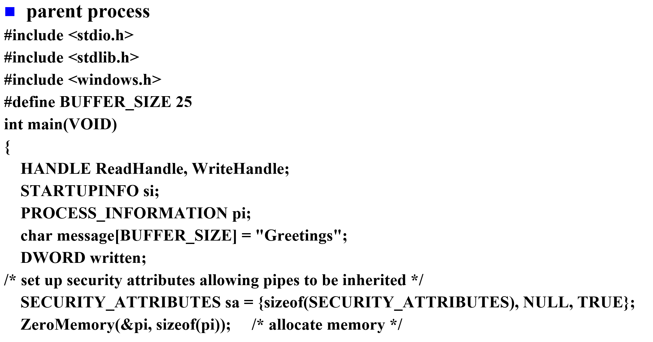
Windows anonymous pipe

Slide 66
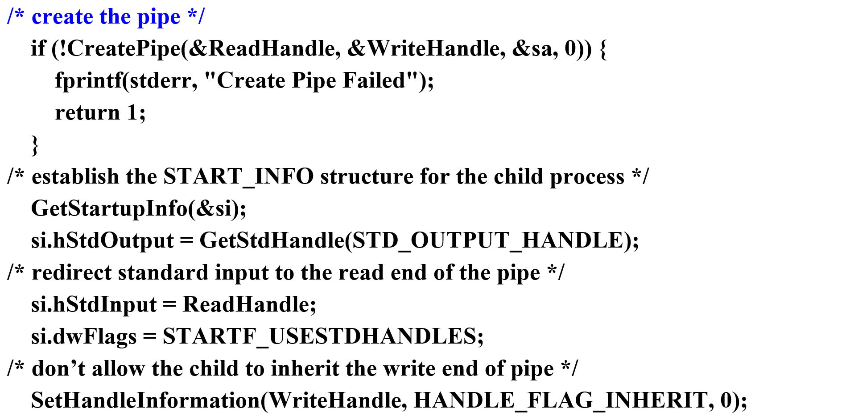
Windows anonymous pipe

Slide 67
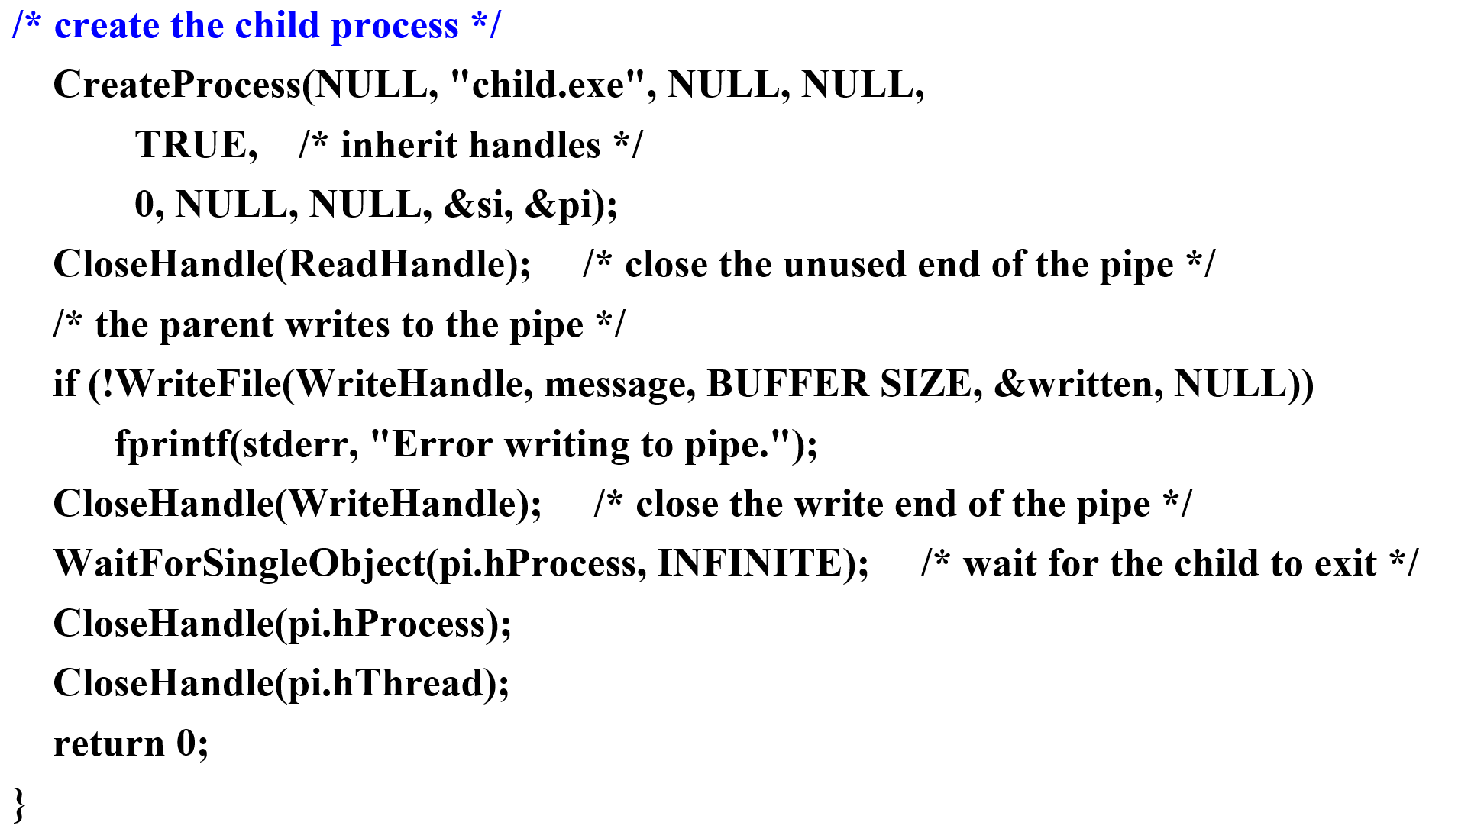
Windows anonymous pipe

Slide 68
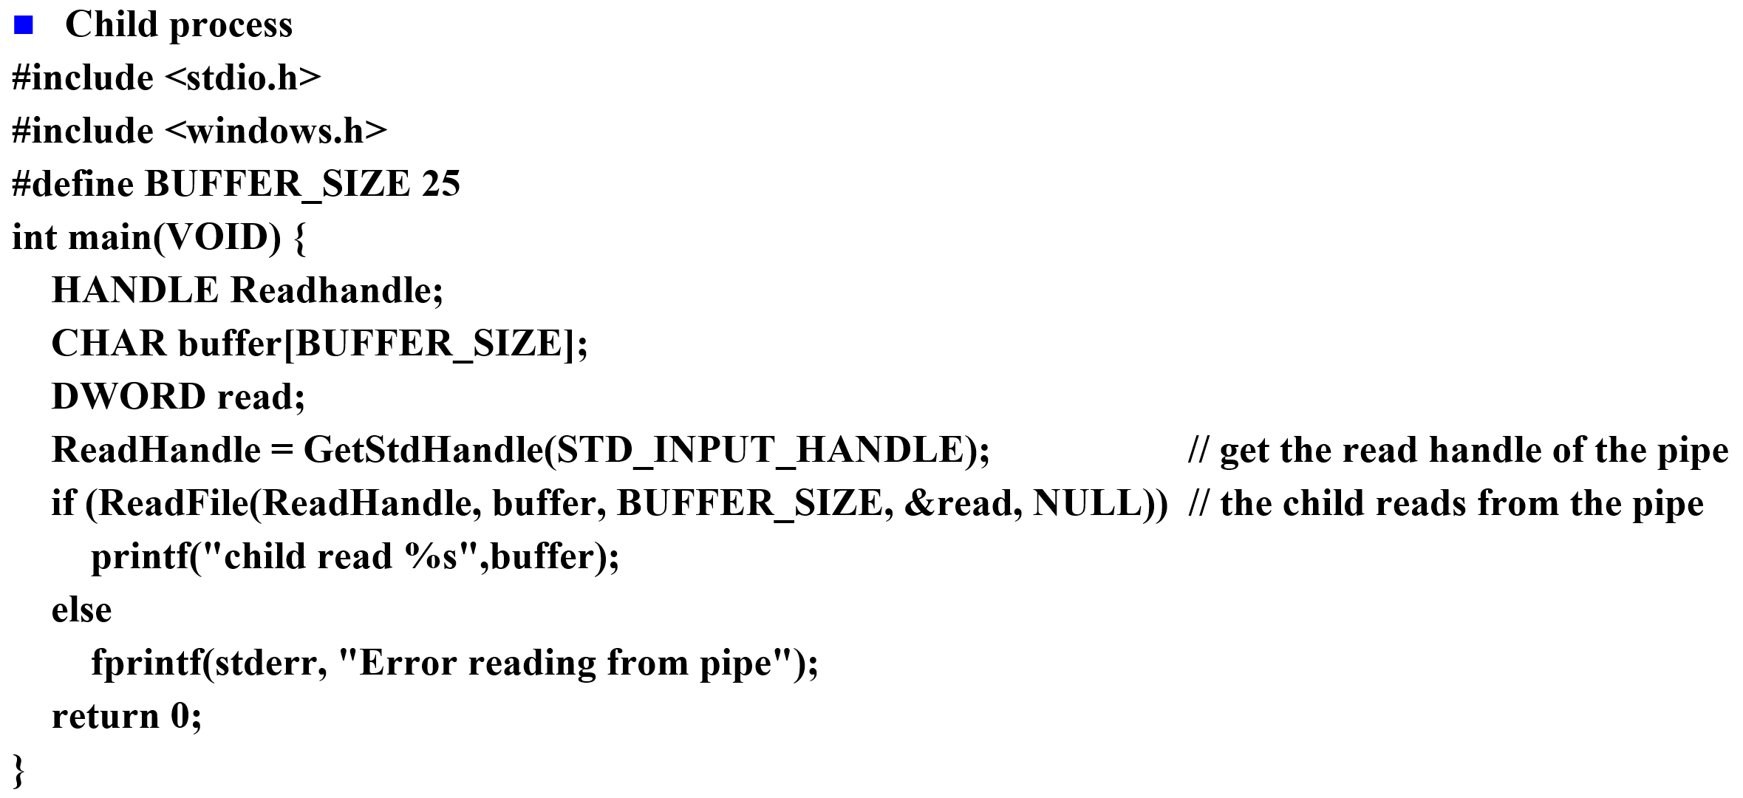
Windows anonymous pipe

Slide 69
Named Pipes
Named Pipes are more powerful than ordinary pipes.
Communication is bidirectional.
No parent-child relationship is necessary between the communicating processes.
Several processes can use the named pipe for communication.
named pipes continue to exist after communicating processes have finished.
Provided on both UNIX and Windows systems.

Slide 70
Named Pipes
Named pipes in UNIX systems referred to as FIFOs
Once created, they appear as typical files in the file system.
System calls
create a FIFO, mkfifo()
manipulate a FIFO, open(), read(), write(), and close()
continue to exist until it is explicitly deleted from the file system.
only half-duplex transmission is permitted.
If data must travel in both directions, two FIFOs are typically used.
only byte-oriented data may be transmitted.
the communicating processes must reside on the same machine.

Slide 71
Named Pipes
Named pipes on Windows
provide a richer communication mechanism.
Full-duplex communication is allowed.
the communicating processes may reside on either the same or different machines.
allow either byte- or message-oriented data.
System calls
Create, CreateNamedPipe()
client connect to a named pipe, ConnectNamedPipe()
Communication, ReadFile() , WriteFile()

Slide 72
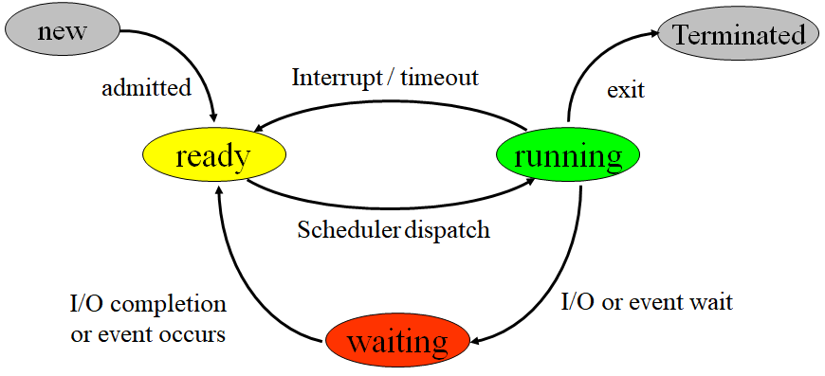
Exercise 6
On a system with n processors,
what is the maximum number of processes that can be in the ready, running, and waiting states?
what is the minimum number of processes that can be in the ready, running, and waiting states?

Slide 73
Exercise 7
For each of the following transitions between process states, indicate whether the transition is possible. If it is possible, give an example of one thing that would cause it.
(1) running → ready
(2) running → waiting
(3) running → swapped waiting
(4) waiting → running
(5) running → terminated

Slide 74
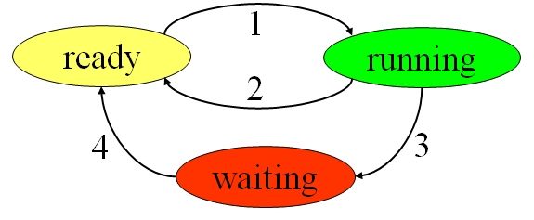
Exercise 8
See the following diagram of process state transition.
Can the following cause and effect transitions be possible?
If yes, give an example.
(a) 2 → 1
(b) 3 → 2
(c) 4 → 1
(d) 1 → 3

Slide 75
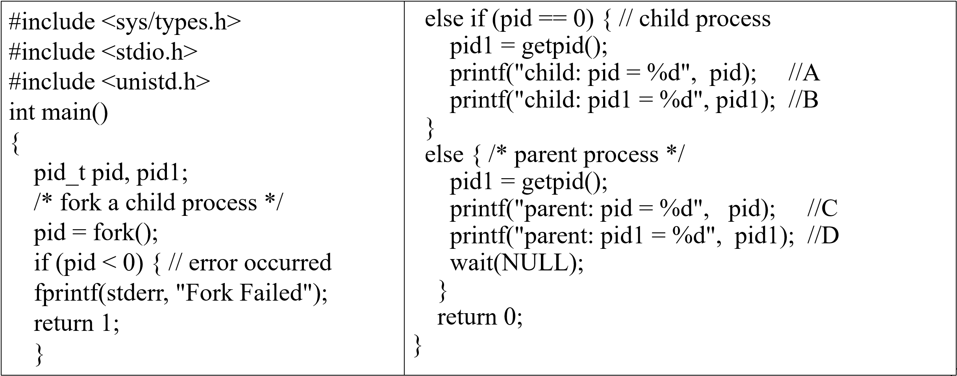
Exercise 9
identify the values of pid at lines A, B, C, and D. (Assume that the actual pids of the parent and child are 2600 and 2603, respectively.)

Slide 76

课后作业及研究性学习
作业：掌握进程的基本概念及其在操作系统中的运行机制。
实验：编程实现进程创建、进程控制和进程间管道通信。
研究性学习
以自己为例，从报名参加高考、到大学毕业，中间会经历哪些状态变化？ 类比理解进程的长期调度、中期调度、和短期调度。
多道程序设计环境下，进程状态转换的影响
思考，同学之间的关系
A1: openEuler PCB
A2:
openEuler
Process Creation
A3: openEuler
Exec()
A4: openEuler
进程终止
A5: openEuler IPC
A5: openEuler Socket

Slide 77
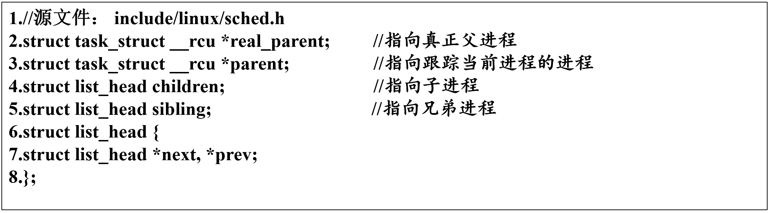
A1: openEuler PCB
Struct task_struct // include/linux/sched.h
Family relationship

Slide 78
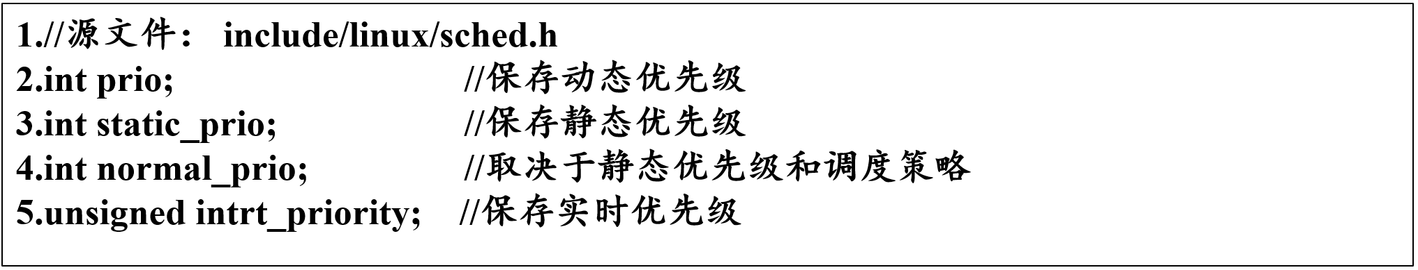
PCB in OpenEuler
Control info.

Slide 79
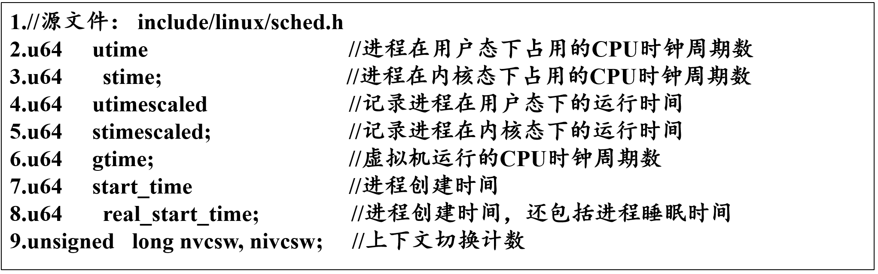
PCB in OpenEuler
Accounting info.

Slide 80
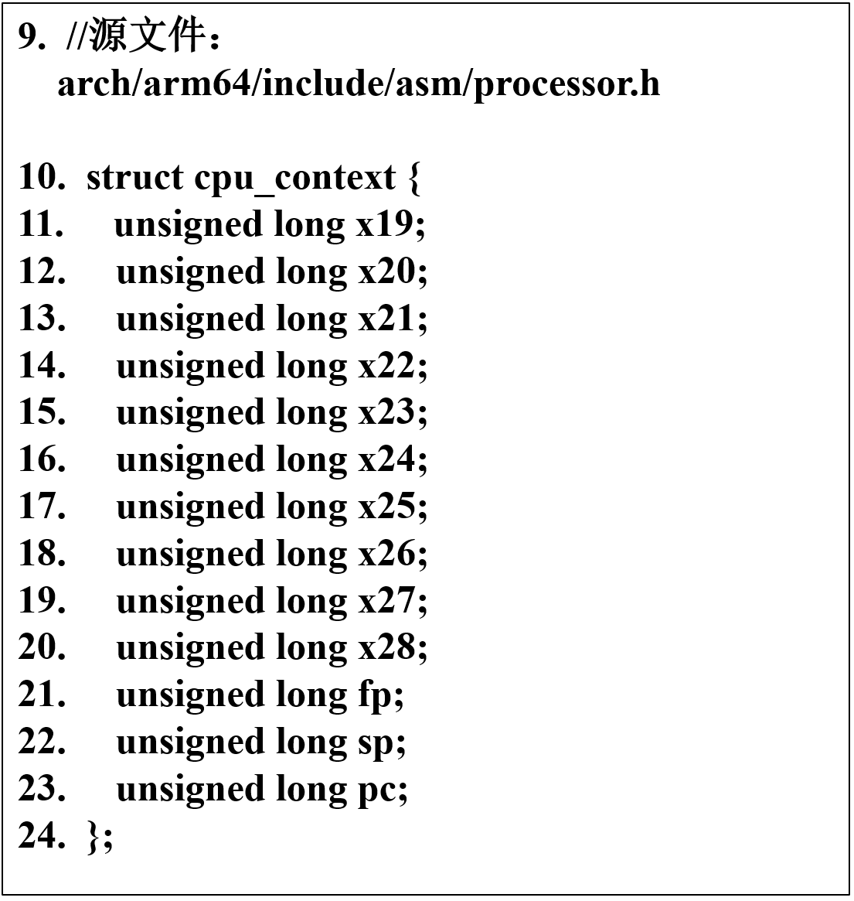
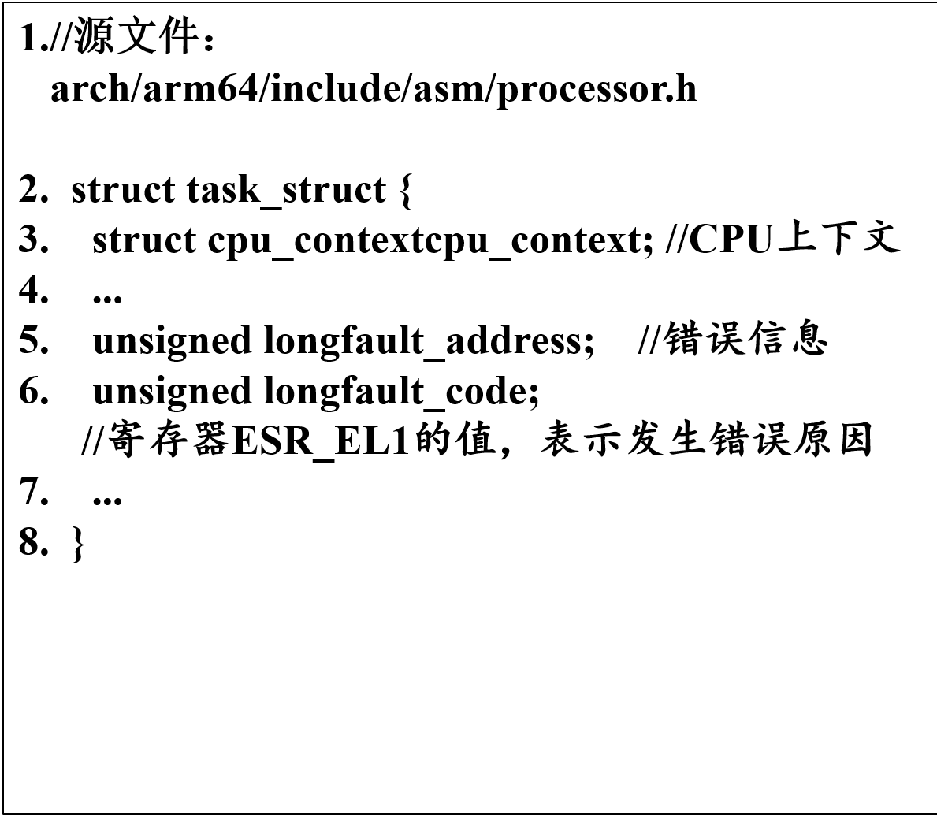
PCB in OpenEuler
CPU context

Slide 81
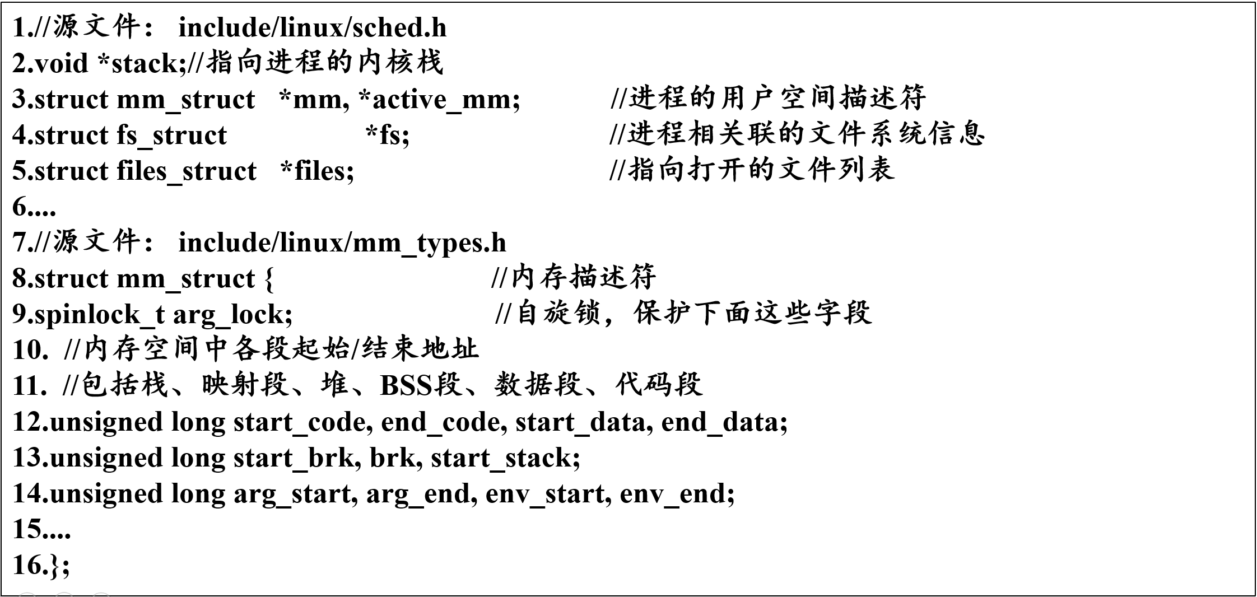
PCB in OpenEuler
Resources info.

Slide 82
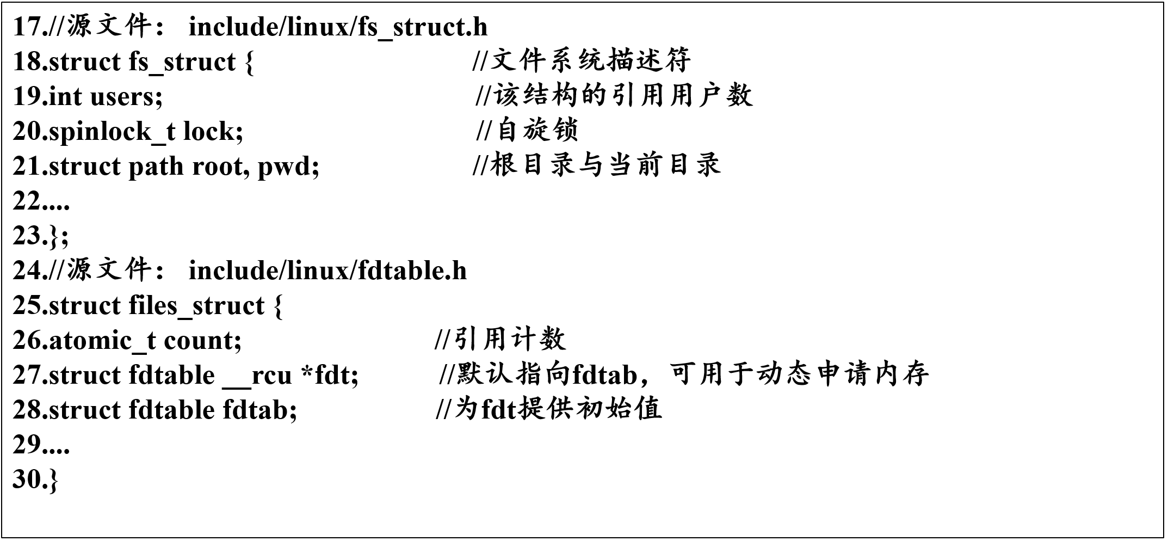
PCB in OpenEuler
Resources info.

Slide 83
A2: openEuler Process Creation
PCB creation and initialization
Setting of process execution environment
Traverse all levels of the page table to complete the copy of the page table
Copy the table items in PTE one by one
Modify the mark of the physical page as read-only

Slide 84
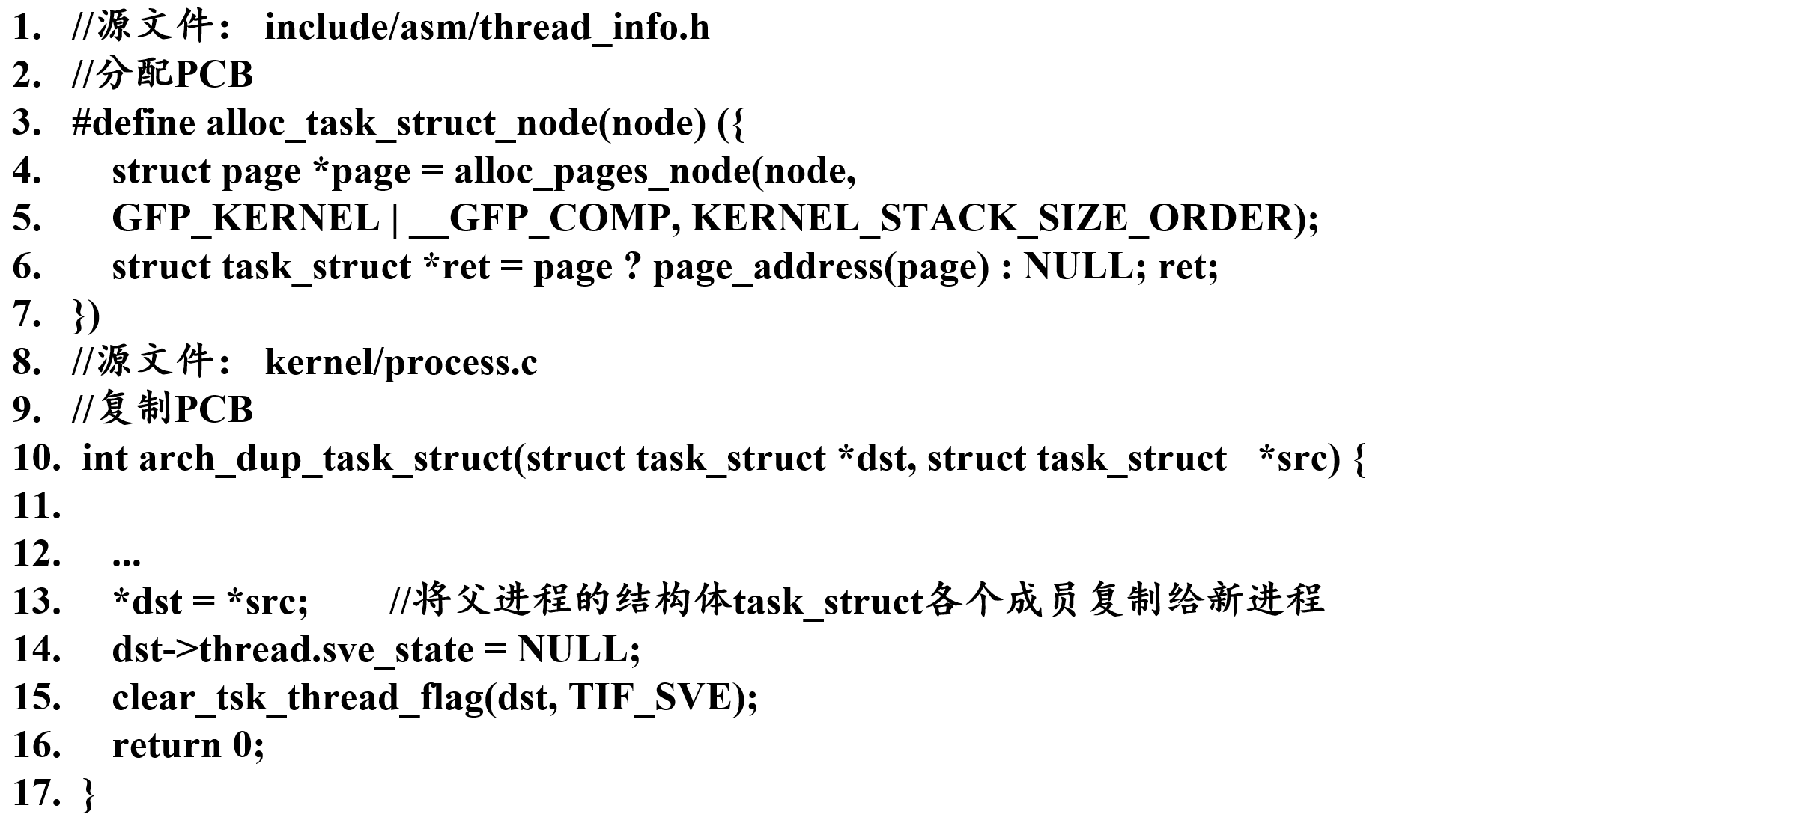
PCB creation and initialization

Slide 85
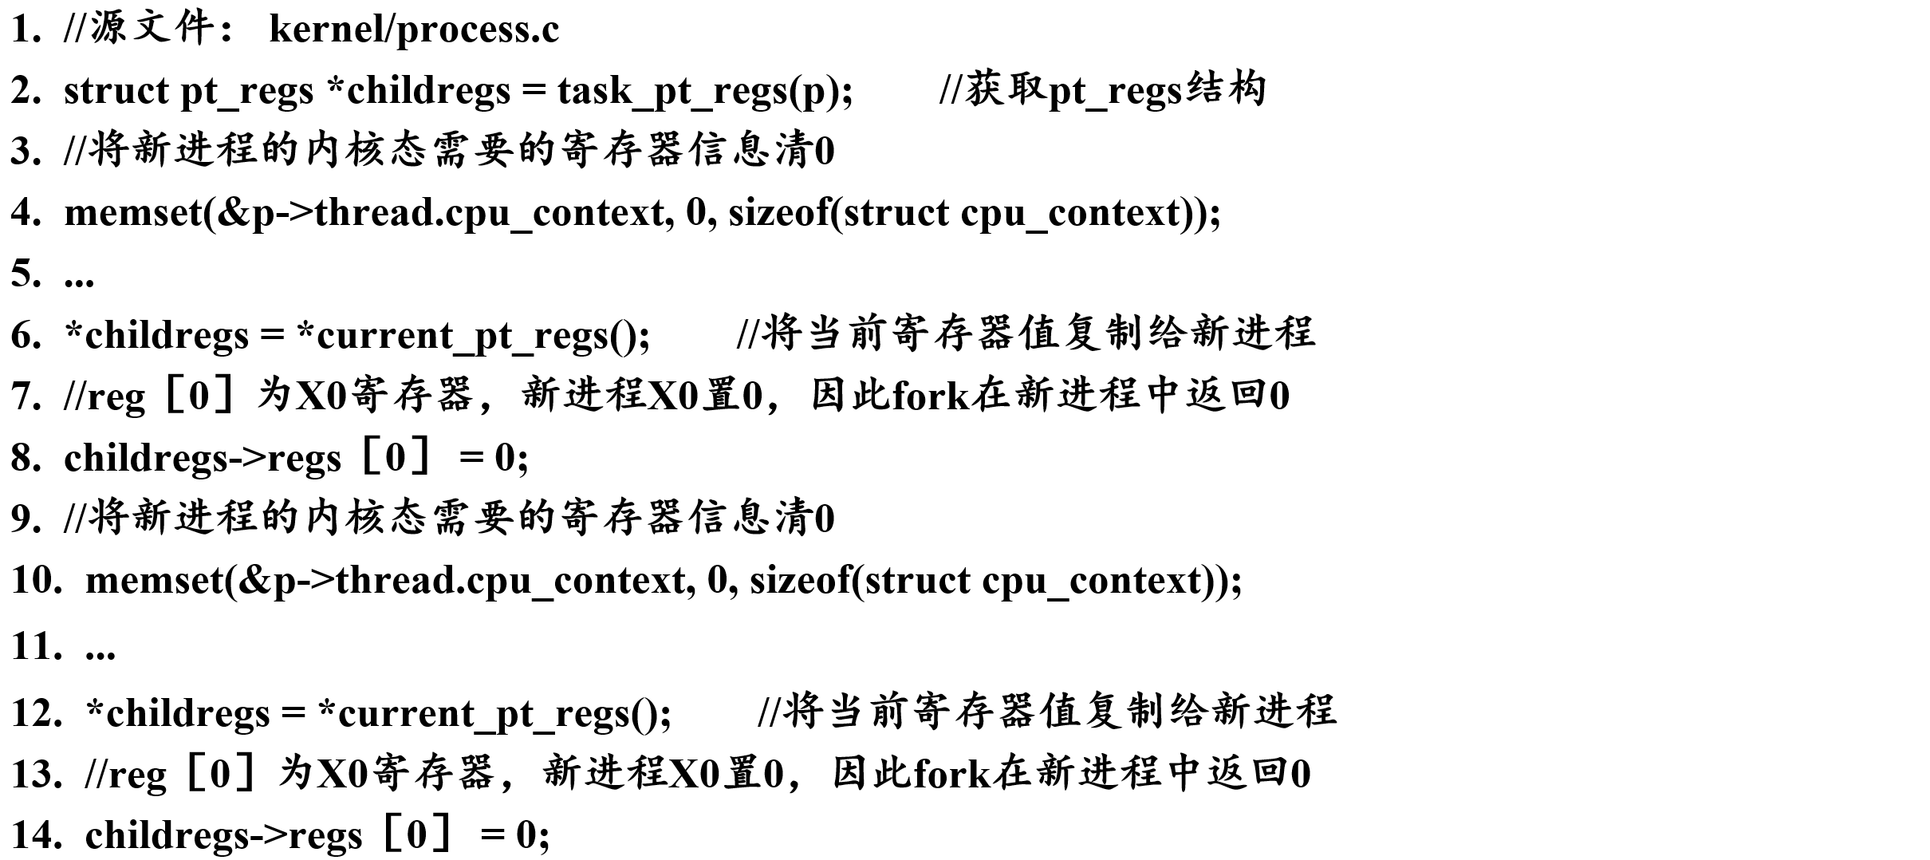
Setting of process execution environment

Slide 86
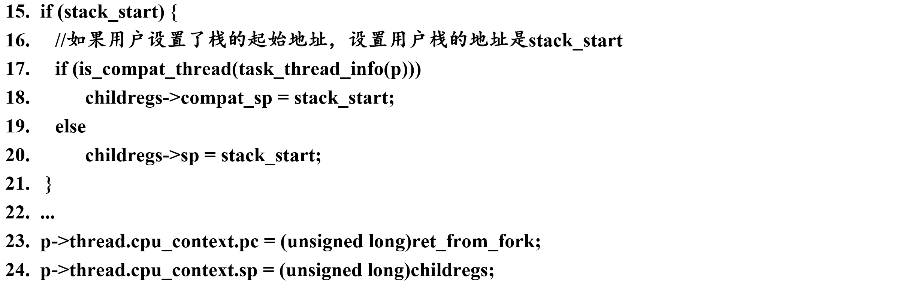
Setting of process execution environment

Slide 87
Traverse all levels of the page table to complete the copy of the page table

Slide 88
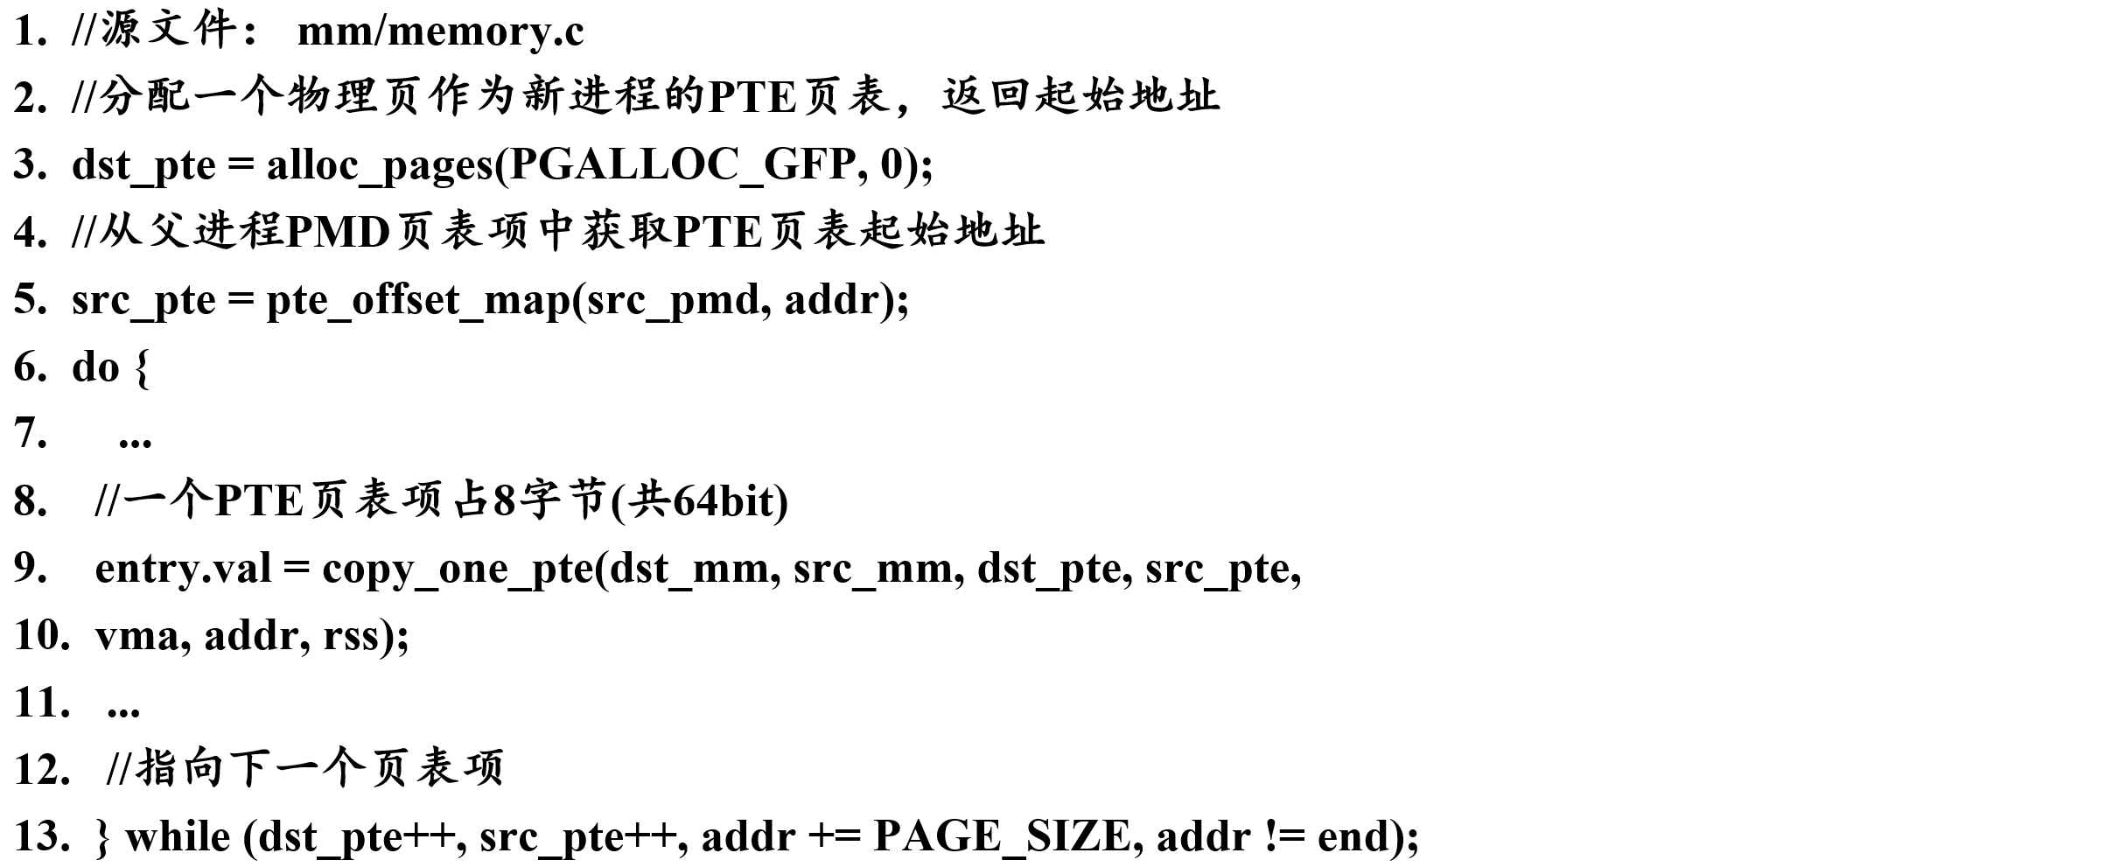
Copy the table items in PTE one by one

Slide 89
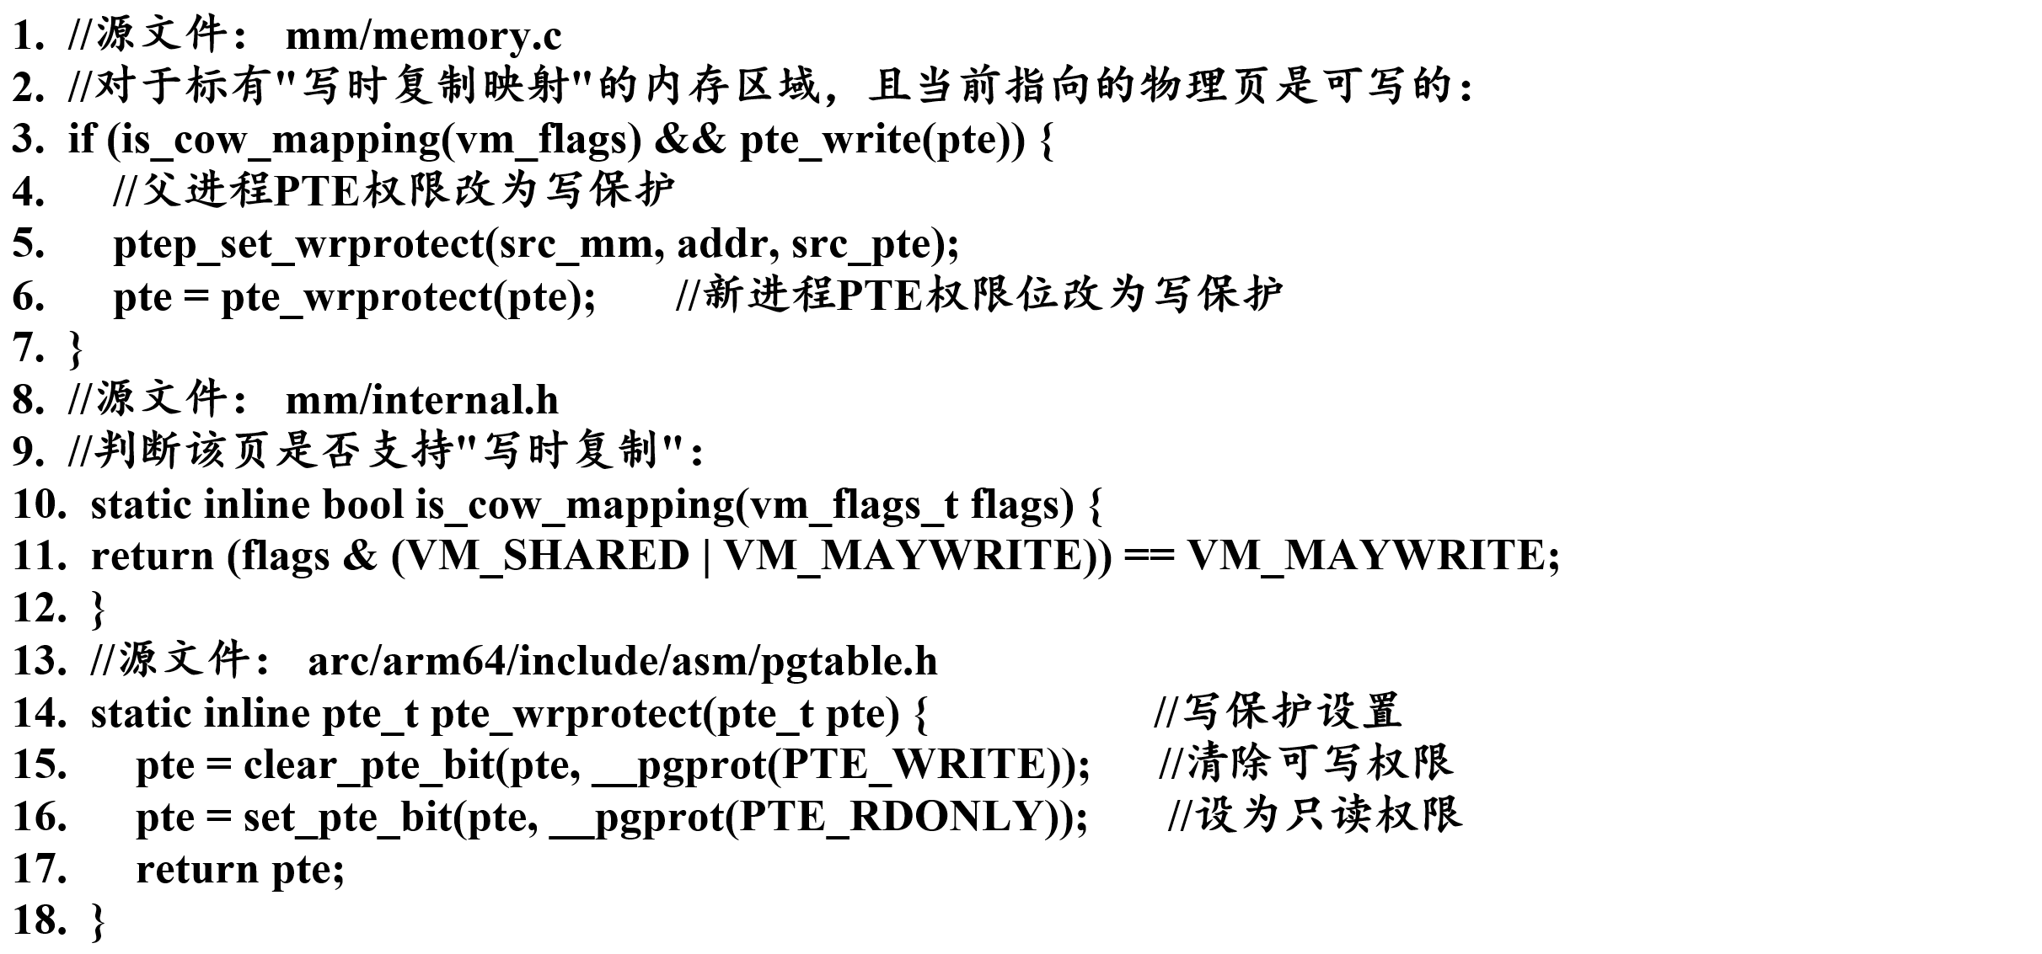
Modify the mark of the physical page as read-only

Slide 90
A3: openEuler Exec()
exec() in OpenEuler
1. exec函数簇的系列函数接口
2. 可执行文件的寻找与打开
3. 可执行文件的装载
4. 新程序的执行

Slide 91
exec() in OpenEuler
exec函数簇用新程序替换调用进程地址空间中的程序实体，包括代码段、数据段，还为调用进程分配新的用户堆栈。
exec函数簇会沿用调用进程的PCB，除了修改其中部分描述资源的成员外，会保留包括进程标识符在内的大部分信息。exec函数簇并不会创建一个新进程，只是为调用进程分配了一个新任务。
除非执行失败会让exec函数簇中的函数返回-1，否则调用进程不会收到返回值，而是直接从新程序的主函数入口开始执行。

Slide 92
1. exec函数簇的系列函数接口
openEuler提供了6种不同的exec函数接口。 用户通过这些接口将文件名、文件路径、环境变量等参数传递到内核，帮助其找到正确的可执行文件。
int execl(char const *path, char const *arg0, ...);
int execlp(char const *file, char const *arg0, ...);
int execle(char const *path, char const *arg0, ..., char const *envp［］);
int execv(char const *path, char const *argv［］);
int execvp(char const *file, char const *argv［］);
int execve(char const *path, char const *argv［］, char const *envp［］);
前5个都是库函数，execve()是系统调用函数。
exec函数簇中的函数最终都是调用函数execve()去完成新程序的加载。

Slide 93
2. 可执行文件的寻找与打开
openEuler中，文件系统的每个目录文件或文件都对应一个inode对象。
inode对象记录了一个文件的重要信息，包括文件字节数、拥有者、读写权限、在外存的位置等。 inode对象并不记录文件名，而是通过特定的inode号码与文件相关联。
为了建立文件名与inode对象的联系，内核还提供了一个dentry对象。
openEuler实现了一个路径查找辅助结构体nameidata，用于根据路径名寻找所需目录或文件的dentry对象。

Slide 94
内核打开可执行文件的流程
文件路径（包括文件名）会由用户调用接口传递到内核。 该路径通常不是完整路径，所以内核需要获取进程当前的工作目录作为查找的起始目录。
内核会从起始目录开始，对路径中的每个分量进行解析，找到各分量对应的dentry对象和inode对象。 例如，路径是a/b/c.txt，那a、b、c.txt都是该路径的分量。内核借助结构体nameidata，最终将找到最后一级分量对应的dentry对象。然后，内核从dentry对象中获得inode号码，进而找到对应的inode对象。
内核从inode对象中获得目标文件在外存中的位置，并打开该文件。 打开文件过程中，有一个关键步骤是内核创建file对象，并将该打开文件的路径、inode对象、文件打开模式等信息填充到file对象中。之后，内核可以通过该file对象直接访问和管理该打开的文件。

Slide 95
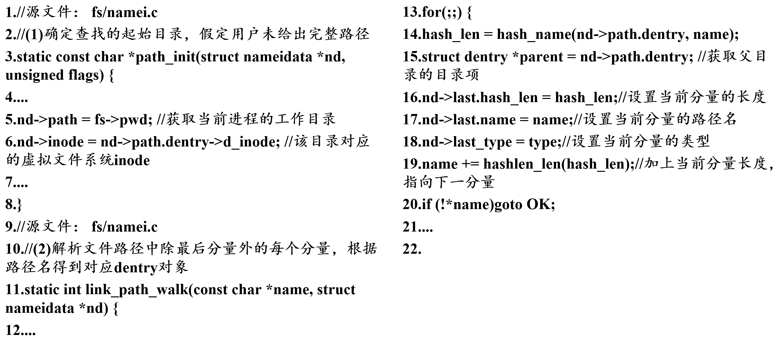
寻找和打开可执行文件的关键代码

Slide 96

寻找和打开可执行文件的关键代码

Slide 97
3. 可执行文件的装载
openEuler中的可执行文件大多是ELF格式。
ELF文件的header包含整个文件的基本信息：如文件大小、Program Header（段头）位置、执行入口地址等。
ELF header通常是ELF文件的前256字节，该部分会被内核率先读入缓存区bprm->buf中。
bprm是struct linux_binprm结构，专用于二进制文件加载过程中参数、数据等的临时保存。
接着，内核从ELF header中获取Program Header地址，并从ELF文件中读出其内容。
Program Header中记录了ELF文件各个Segment的地址及大小。
内核可以借助这些内容，通过一个for循环将ELF文件的代码段、数据段等都映射到内存中，并将相应信息记录在调用进程的内存描述符对应成员中。

Slide 98

装载可执行文件的关键代码

Slide 99
4. 新程序的执行
内核将代码段、数据段等映射到内存后，还需要更新这些Segment在地址空间中的起始地址和结束地址。
之前，这些地址只是偏移地址，加上映射在内存中的起始地址load_bias后，就真正指向各个Segment在地址空间中的位置。
然后，内核将从ELF header中获取的入口地址设为程序执行的入口地址。
程序的执行还需要用户堆栈、寄存器的配合。内核需要将辅助向量（auxiliary vector）、环境变量、用户参数等一一入栈，构建如图所示栈。

Slide 100
初始用户栈的内容构建
辅助向量是一种从内核到用户空间的信息交流机制。
内核还需为结构体pt_regs中各寄存器成员设置正确的值，包括PC、PSTATE、SP 等。
这些成员通常保存着程序运行中断时的CPU上下文。
当程序装载完毕、进程正常执行时，结构体pt_regs中各成员内容会被写到CPU的各个寄存器中。
程序可以从程序计数器PC中保存的主函数入口地址开始执行。

Slide 101

执行新程序的关键代码

Slide 102

执行新程序的关键代码

Slide 103

执行新程序的关键代码

Slide 104
A4: openEuler 进程终止
进程终止
僵尸进程的处理策略
exit()
孤儿进程
1. 用户空间资源的回收
2. 状态信息的发送与僵尸状态的设置
3. 内核资源的回收
4. 为所有子进程寻找新父进程

Slide 105
进程终止
openEuler中，父进程创建子进程后，通常使用系统调用wait()或waitpid()进入阻塞状态，直到获取了子进程终止信号才继续执行。
系统调用wait()等待任一子进程的终止，而系统调用waitpid()只等待进程PID与参数pid相同的子进程。
当参数pid为-1时，这两个系统调用等效。
如果waitpid()的参数中传入标志WNOHANG，那么父进程是以一种非阻塞的方式回收子进程。
得到子进程终止的信号后，父进程会陷入内核去回收子进程的剩余资源。
在父进程调用wait()之前，处于僵尸状态的子进程称为僵尸进程，它们持有着一定的内核资源但又不会被任何信号结束。

Slide 106
僵尸进程的处理策略
为了降低僵尸进程的危害，openEuler采取了许多策略，重要的4种：
父进程终止时，自动调用wait()帮助处于僵尸状态的子进程完成终止；
如果父进程提前因异常终止，那么init进程会定期调用wait()清除僵尸进程；
为了有效避免僵尸进程的产生，如果进程不被跟踪，内核将不会向其父进程发送状态信息而直接回收该进程全部非共享资源；
某些父进程并不负责子进程剩余资源回收。 在这种情况下，内核在向父进程发送状态信息后，会直接回收子进程的剩余资源，使得子进程不进入僵尸状态而是变为死亡状态。

Slide 107
exit()
openEuler中，进程终止主要是通过系统调用exit()与wait()配合来完成的。
exit()主要完成两部分工作：
回收当前进程的用户空间所占用的内存资源；
向当前进程的父进程发送状态信息，并判断父进程是否愿意回收当前进程的剩余资源。
如果父进程的SIGHAND信号处理函数设为SIG_IGN或是处理标志设置了SA_NOCLDWAIT，表明父进程不关心当前进程的终止，那么exit()会继续回收当前进程剩余内核资源； 否则，让当前进程进入僵尸状态，并等待父进程调用wait()去接收这些信息并完成资源回收。

Slide 108
孤儿进程
当前进程可能还存在多个运行正常的子进程（未成为僵尸进程），这些失去父进程的子进程称为孤儿进程。
内核需要为孤儿进程寻找新的父进程，用于接收和处理孤儿进程的状态信息并在它们终止时予以帮助。

Slide 109
1. 用户空间资源的回收
进程终止时，内核优先回收的是当前进程所占用且不与其他进程共享的用户空间资源。
映射到进程用户空间的物理内存有三个组成部分：
分配到的物理内存；
页表占用的物理内存；
内存描述符占用的物理内存。
内核也需要分三个过程回收这些资源
PTE页表中的每个不为空的PTE页表项都指向一个待回收的物理页。
同一个物理页可以被映射到多个进程的地址空间中，所以内核需要先检查物理页的引用计数，只有引用计数为零的物理页才能被释放。

Slide 110
用户空间资源的回收
内核也需要分三个过程回收这些资源（续）
清除所有PTE页表项，意味着解除了当前进程页表与物理内存的映射关系，那么其页表所占用的内存也可以回收了。
在获取上一级页表的页表项内容后，内核将该页表项置0，并根据其内容找到下一级页表所在物理页，在判断物理页引用计数为0后释放它。
内存描述符、进程标识符、PCB以及内核栈等内核重要数据结构对象通常比较小且需要频繁分配和回收。为了加速对它们的管理，这些对象通常被组织为slab块。
内核在回收slab块时，并不会直接释放它们占用的物理内存，而是将其作为一个空闲对象回收到slab块的空闲链表中。
内核将当前内存描述符回收到结构体指针mm_cachep指向的slab空闲链表中。

Slide 111

内存资源回收的关键代码

Slide 112

内存资源回收的关键代码

Slide 113
2. 状态信息的发送与僵尸状态的设置
回收了大部分资源后，内核会将当前进程设为僵尸状态（EXIT_ZOMBIE），使其被调度器忽略。
之后，内核还需要向当前进程的父进程发送SIGCHLD信号与状态信息。
SIGCHLD信号用于提醒父进程去回收子进程剩余资源，状态信息主要包括pid、exit_code以及当前进程运行时间等。
exit_code可以帮助父进程判断当前进程是正常终止还是异常终止。
此时，父进程可能正因系统调用wait()而处于阻塞状态。因此，内核还需要唤醒父进程，使其可被调度并接收信号。

Slide 114

发送状态信息的关键代码

Slide 115
3. 内核资源的回收
回收子进程占用的PID（进程标识号）。
为了能根据PID快速索引到PCB，openEuler引入了PID散列表。
在子进程终止后，内核会先从PID散列表中删除它的PID，然后将该PID回收到slab的空闲链表中。
将进程的PCB从进程链表中删除。
openEuler内核中存在进程链表（一个双向循环链表），用于链接所有进程的PCB。
把子进程的内核栈、PCB回收到slab cache的空闲链表中。
内核栈对应结构体指针thread_stack_cache指向的链表；
PCB对应结构体指针task_struct_cachep指向的链表。

Slide 116

内核资源回收的关键代码

Slide 117

内核资源回收的关键代码

Slide 118
4. 为所有子进程寻找新父进程
由于僵尸进程会一直占用内核资源进而影响新进程的创建，所以在当前终止的进程还有大量子进程未终止的情况下，内核必须为它们寻找新的父进程，否则这些子进程终止时可能会变成无法销毁的僵尸进程，带来巨大的危害。
内核会优先从当前进程所在的进程组中寻找合适的父进程。
内核遍历该进程组，选中第一个未执行终止操作的进程（即进程标志位不是PF_EXITING）。
如果进程组内除init进程外的其他进程都已开始终止，那么当前进程的所有子进程会被挂载到init进程下。
之后，某个子进程终止时，会等待init进程调用wait()完成它的终止。

Slide 119

为子进程寻找新父进程的关键代码

Slide 120

为子进程寻找新父进程的关键代码

Slide 121
A5: openEuler IPC
openEuler 共享内存
openEuler 消息传递

Slide 122
共享内存
主要步骤
进程A创建一块共享内存区
进程A和B分别将共享内存映射到各自的地址空间
进程A和B通过读/写共享内存区进行通信
当不需要进行通信时，进程A和B分别解除在地址空间中对该共享内存区的映射
释放共享内存区

Slide 123

openEuler 共享内存的实现
主要数据结构
openEuler通过虚拟文件系统shmfs来管理共享内存
一个共享内存区对象被抽象成shmfs文件系统中的一个文件。
在共享内存文件的结构体file中，成员f_inode用来映射共享内存区所在的页框。

Slide 124
openEuler 共享内存的实现

Slide 125
函数shmget()
用来获得共享内存区的ID，如不存在，则创建一个。
int shmget(key_t key, int size, int shmflg);
key，共享内存区的唯一标识符
size，共享内存区的大小，字节
shmflg，表示共享内存区的属性 IPC_CREAT，如不存在，则创建，否则打开共享内存区 IPC_EXCL，如不存在则创建，否则返回错误信息
当一个key值所标识的内存区已被创建，进程再以相同的key值调用shmget()时，shmget()将直接返回该key值对应的共享内存的ID，不再分配一块新的共享内存区，从而实现多个进程访问到同一块内存。

Slide 126
函数shmget()
调用了系统调用函数sys_shmget()
openEuler使用宏定义函数SYSCALL_DEFINE3()将函数ksys_shmget()封装成系统调用函数sys_shmget()。
ksys_shmget()中，将shm_ops中的操作函数getnew()设置为函数newseg()，当进程需要新建一块共享内存区时，就执行函数newseg()。
函数newseg()完成对共享内存区的初始化
根据shmget()中的参数size计算出锁申请共享内存区页框的数量，如内存不足，返回错误信息；如有足够内存，则把参数key的值赋予它。
创建一个结构体shmid_kernel实例shp.
在文件系统shm中创建并打开一个共享内存文件file，创建一个文件节点f_inode（在函数shmem_kernel_file_setup()中）
初始化shp
为该共享内存区分配一个ID，建议ID到shp的映射
返回该ID

Slide 127
函数shmat()
用来将某个共享内存区映射到一个进程的地址空间中。
void shmat(int shmid, char * shmaddr, int shmflg);
shmid，共享内存区的ID
shmaddr，进程建议的即将被映射的目标地址 若为0，则有内核根据进程地址空间的使用情况进行分配 否则，对该地址进行页对齐修正，用修正后的值作为虚拟地址的起始地址。 从起始地址开始，向上延伸共享内存区的大小，这段区域就是映射到进程地址空间中的虚拟内存区域，
shmflg，进程对共享内存区的操作权限，SHM_RDONLY只读
调用了系统调用函数sys_shmat()
openEuler使用宏定义函数SYSCALL_DEFINE3()将函数do_shmat()封装成系统调用函数sys_shmat()。

Slide 128
函数shmat()
建立共享内存文件到虚拟地址的映射，函数do_mmap_pgoff() 调用函数mmap_region()
创建 一个结构体vm_area_struct，记录共享内存的虚拟地址空间
记录该虚拟地址空间对应的共享内存文件
建立虚拟地址空间到共享内存区文件的映射
当进程首次访问共享内存的地址空间时，产生缺页中断
缺页中断处理时（函数shmen_fault()），将执行函数mmap()，完成回溯函数的注册
函数shmen_fault()
获取产生缺页的虚拟地址对应的vma记录
获取该vma记录对应的文件节点inode
为共享内存文件分配一个页框
调用函数set_pte_at()设置进程页表，建立虚拟地址到物理地址的映射。

Slide 129
函数shmdt()
解除一个进程的虚拟地址空间到共享内存区的映射
void *shmdt(char * shmaddr);
调用系统调用函数sys_shmdt()
openEuler使用宏定义函数SYSCALL_DEFINE1()将函数ksys_shmdt()封装成系统调用函数sys_shmdt()。

Slide 130
函数shmctl()
对共享内存区执行一些杂项的操作，如获取状态、销毁等
void *shmctl(int shmid, int cmd, struct shmid_ds *buf);
cmd，操作，IPC_RMID，销毁共享内存区
buf，用于传递与cmd指定操作相关的数据，对于IPC_RMID，忽略buf
调用系统调用函数sys_shmctl()
openEuler使用宏定义函数SYSCALL_DEFINE3()将函数compat_ksys_shmctl()封装成系统调用函数sys_shmctl()。

Slide 131

示例

Slide 132



openEuler 消息传递
主要数据结构
用户空间中的消息数据结构
结构体msg_msgmsg
消息头的数据结构

Slide 133
openEuler 消息传递
消息链表
消息结构（大/长消息）

Slide 134
openEuler 消息传递
消息队列

Slide 135
消息队列的创建
在用户态，进程使用函数msgget()创建消息队列
int msgget(key_t key, int msgflg);
key，消息队列的唯一标识
msgflg，其值一般为IPC_CREAT
在操作系统中，如果不存在该key值得消息队列，则创建一个标识为key得消息队列，返回队列ID；
如果已存在，则直接返回队列得ID。
调用系统调用函数sys_msgget()，内核中， sys_msgget()又调用函数newque()
newque()
kvmalloc()为队列头申请一块内存；
对队列头初始化：
ipc_addid()获取该消息队列的ID值，并将该ID返回

Slide 136
发送原语msgsnd()的实现
int msgsnd(int msqid, const void *msg_ptr, size_t msg_sz, int msgflg);
msqid ，消息队列ID
msg_ptr ，存储待发送消息的用户空间首地址
msg_sz ，消息正文长度
msgflg ，同步方式，阻塞/非阻塞
调用系统调用函数sys_msgsnd()，内核中，最终调用函数do_msgsnd()
函数do_msgsnd()
将待发送消息正文复制到锁申请的内核空间中，返回指向该消息的指针；
设置消息类型
根据msgsnd()传入的消息队列ID找到相应的队列

Slide 137
发送原语msgsnd()的实现
函数do_msgsnd()
获取锁，并检查消息队列中是否有足够的空间
有，尝试将消息直接发送给正在等待接收该消息的进程，若没有进程等待，则加入消息链表中，更新消息队列的总字数、总消息数
无，阻塞方式：将发送进程添加到消息队列的被阻塞发送进程链表中
无，非阻塞昂是，直接退出函数执行
释放锁，重新调度
被阻塞的发送进程重新获得CPU之后，
获取锁
将自己从消息队列的被阻塞发送进程链表中删除
重新检查消息队列是否有足够的空间存储待发送消息。

Slide 138
接收原语msgrcv()的实现
ssize_t msgrcv(int msgid, void *msgp, size_t msgsz, long msgtyp, int msgflg);
msgid ，消息队列ID
msgp ，存储待接收消息缓冲区的用户空间首地址
msgsz ，可接受消息的最大长度
msgtyp ，要接收消息的类型
msgflg ，同步方式，阻塞/非阻塞
调用系统调用函数sys_msgrcv()，内核最终调用函数do_msgrcv()
do_msgrcv()
根据msgrcv()传入的消息队列ID找到对应的消息队列
获取锁
find_msg()根据传入的消息类型在消息队列中找该类型的消息

Slide 139
接收原语msgrcv()的实现
找到：
将该消息从消息链表中删除，更新队列头内容
ss_wakeup()遍历消息队列上被阻塞的发送进程链表，只要消息队列中有足够的空间，就将发送进程从链表中删除，并唤醒
函数msg_handler()将消息正文从内核空间复制到用户空间
函数free_msg()释放内核空间中的消息
没找到，阻塞方式
接收进程被添加到消息队列的被阻塞接收进程链表中
函数do_msgrcv将接收进程的状态设置为TASK_INTERRUPTIBLE
释放锁
重新发起调度
没找到，非阻塞方式
直接退出函数执行
被阻塞的接收进程重新获得CPU后，从链表中删除，再次尝试在消息队列中查找相应类型的消息。

Slide 140

示例：发送进程
示例：接收进程

Slide 141
A6: openEuler Socket
TCP 连接状态
连接队列
建立连接需要的数据结构
建立连接的步骤
关闭连接
数据传输

Slide 142

TCP 连接状态

Slide 143
连接队列
单CPU的服务端在同一时间只能处理一个连接
当由多个客户端尝试与服务端建立连接时，服务端应当能够对暂时无法响应的连接请求进行缓存，以便后续再进行处理。
openEuler提供了两个连接队列：半连接队列、全连接队列

Slide 144

建立连接需要的数据结构

Slide 145
建立连接的步骤
创建socket
服务端调用函数listen()进入监听状态
服务端调用函数accept()等待与客户端建立连接
客户端发起第一次“握手”
服务端处理第一次“握手”并发起第二次“握手”
客户端处理第二次“握手”并发起第三次“握手”
服务端处理第三次“握手”信号

Slide 146

1. 创建socket
连接之前，客户端和服务端都要调用函数socket()创建与结构体socket相关的资源。

Slide 147

2. 服务端调用函数listen()进入监听状态
函数完成两项工作
指定全连接队列大小
将主动socket转换为被动socket

Slide 148

3. 服务端调用函数accept()等待与客户端建立连接

Slide 149

4. 客户端发起第一次“握手”

Slide 150

5. 服务端处理第一次“握手”并发起第二次“握手”

Slide 151

6. 客户端处理第二次“握手”并发起第三次“握手”

Slide 152

7. 服务端处理第三次“握手”信号

Slide 153
关闭连接

Slide 154
客户端主动发起关闭连接，步骤
客户端发送第一次“挥手”信号；
服务端接收第一次“挥手”信号并发送第二次“挥手”信号；
客户端接收第二次“挥手”信号；
服务端发送第三次“挥手”信号；
客户端接收第三次“挥手”信号并发送第四次“挥手”信号；
服务端接收第四次“挥手”信号。

Slide 155

1.客户端发送第一次“挥手”信号

Slide 156

2. 服务端接收第一次“挥手”信号并发送第二次“挥手”信号

Slide 157

2. 服务端接收第一次“挥手”信号并发送第二次“挥手”信号

Slide 158

3. 客户端接收第二次“挥手”信号

Slide 159
数据传输
需解决的问题
当发送数据时，遇到内核缓冲区满
当接收数据时，遇到内核缓冲区空
高并发场景，进程如何高效地管理多个连接
阻塞和非阻塞
I/O复用

Slide 160
数据传输：阻塞和非阻塞
阻塞I/O：
进程在读取数据时，如果数据还未就绪，则该进程将被内核阻塞，进入阻塞状态等待数据。
内核准备好数据后，将唤醒进程复制数据。
优点：
不会浪费CPU资源
缺点：
进程无法同时处理多个I/O，效率低

Slide 161
阻塞和非阻塞
非阻塞I/O：
进程在读取内核数据时，如果数据未就绪，进程会立即返回，继续运行。
过一段时间后，进程再次读取内核缓冲区，如此往复，直到读到所需数据。
轮询（polling）
优点：
进程可以同时处理多个I/O
缺点：
浪费CPU周期查询未就绪数据

Slide 162

函数recvfrom()

Slide 163

数据传输：I/O复用
能够让内核监听进程创建的所有socket描述符。
openEuler支持三个I/O复用模型：
Select
Poll
epoll
Select模型

Slide 164

I/O复用—select机制

Slide 165
I/O复用—epoll机制
select的改进版
将就绪的（而不是所有的）socket描述符返回给进程
避免让进程遍历所有描述符
epoll支持的描述符数量没有限制
很好地胜任高并发的场合

